Slide 1
Thinking Cities with Elsewhere
Putting comparison to work for a more global urban studies

Slide 2
I – Inventing new grounds for urban comparison

Slide 3
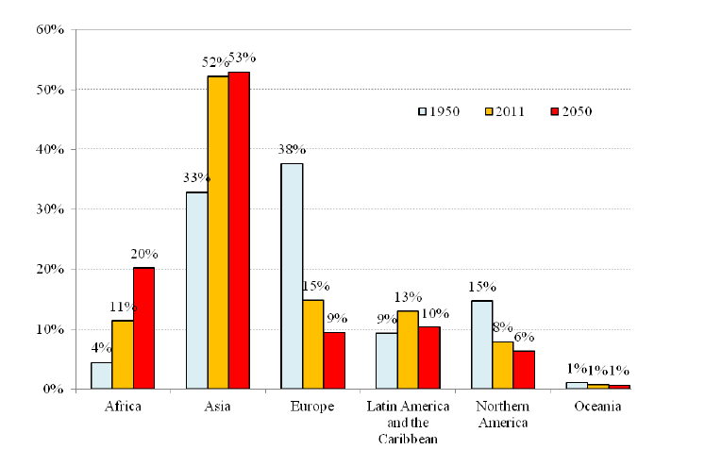
Changing proportion of the world’s urban population by region, 2011 estimates
(source: UN World Urbanisation Prospects, 2011, Highlights)
Notes:
World Urbanisation Prospects 2011 Highlights

Slide 4
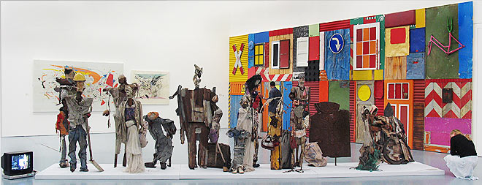
“Cities in the global North and South are not incommensurable but need to be regarded as ‘neighbours’ in a single metropolitan space (Simone, 2010: 263) and as one element of the same analytical field.” (Lanz, 2013: 18) [Global Prayers].
“Inherited analytical vocabularies and cartographic methods do not adequately capture the changing nature of urbanization processes, and their intensely variegated expressions, across the contemporary world.” (Brenner and Schmid, 2014)
“to push the ways in which connections across cities in Asia and Africa could be envsioned… to imagine the proximity of cities from Dakar to Jakarta” (Simone, 2010, p. 267)

Slide 5
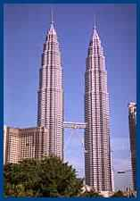
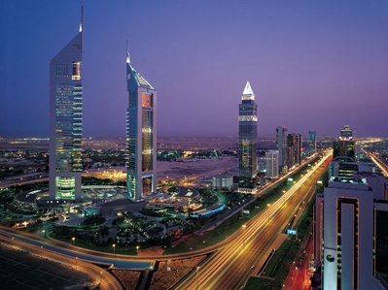
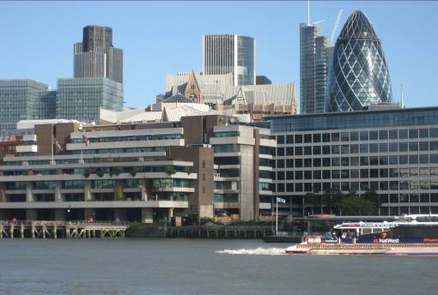
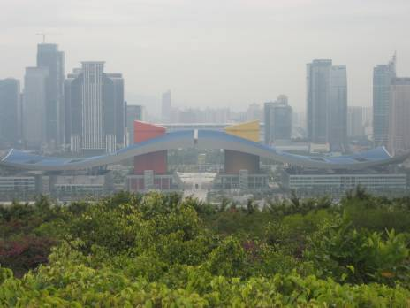
There is a need to produce understandings of cities which account for the great diversity of cities across the globe; and where the cutting edge of urbanism is no longer in the West…we need to build theories and concepts of cities “seeing from the South” (Watson, 2009; Parnell, Pieterse, Watson 2010).
London as a Theory Destination?

Slide 6
 | Comparative strategy/ basis for selection | Causality assumptions
Can’t compare | None | Plural and incommensurable
Individualising | Implicit Any city Case studies not always comparative or theory-building | Historical and specific
Universalising | Most similar or most different | Search for a general rule (universal)
Encompassing | Involvement in common systemic processes; often assumption of convergence as basis for comparison | Universal but potentially differentiated processes of incorporation into and impact of system
Variation finding | Most similar; explain systematic variations within broadly similar contexts on basis of variables held constant or changing | Universal
 | Most different | Either: search for universal laws across different contexts Or: Pluralist causalities (Pickvance, 1986)
“Cities in a world of cities” (IJURR, 2011)

Slide 7
“comparisons as involving the broad practice of thinking cities/the urban through elsewhere (another case, a wider context, existing theoretical imaginations derived from other contexts, connections to other places), in order to better understand outcomes and to contribute to broader conceptualizations and conversations about (aspects of) the urban. Thinking comparatively can highlight the differentiation of outcomes; it can bring into view the distinctive (or shared) processes shaping a certain urban outcome; it can put to work theoretical insights drawn from other instances or cases; it can insist on the incompleteness of analytical insights brought to attention from different contexts.
Moreover, a comparative imagination can suggest new objects of analysis by displacing ethnocentric assumptions which arise from the inevitable locatedness of all theory”

Slide 8
What is a case??
A particular for specified universals..
A hybridised outcome, a defanged empiricism…
A concrete (open) totality… (multiplicity of processes)
A singularity… (its own phenomenon; one of a multiplicity of inter-related outcomes)

Slide 9
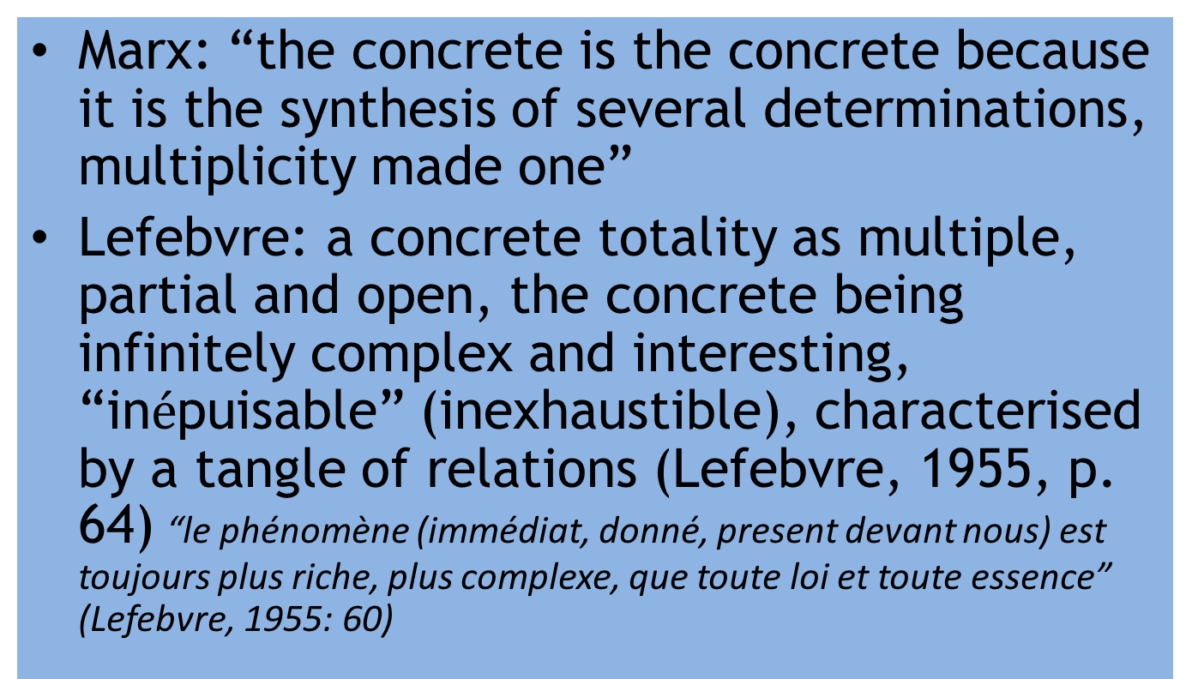
Open/concrete totalities
Marx: “the concrete is the concrete because it is the synthesis of several determinations, multiplicity made one”
Lefebvre: a concrete totality as multiple, partial and open, the concrete being infinitely complex and interesting, “in$é$puisable” (inexhaustible), characterised by a tangle of relations (Lefebvre, 1955, p. 64) “le phénomène (immédiat, donné, present devant nous) est toujours plus riche, plus complexe, que toute loi et toute essence” (Lefebvre, 1955: 60)

Slide 10
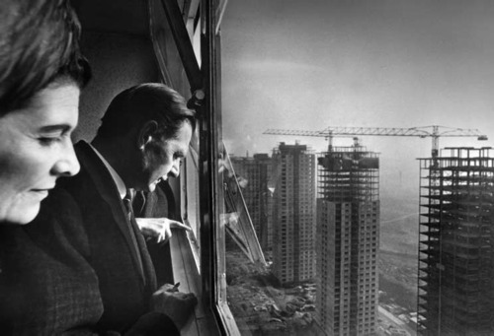
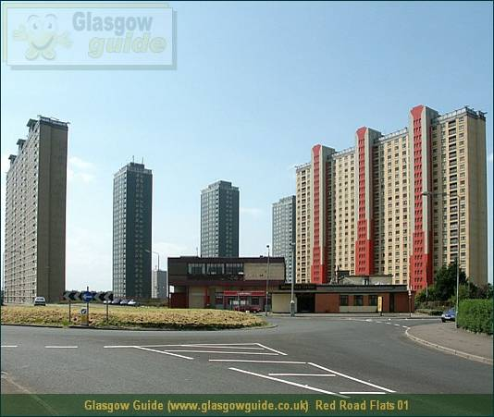
“To work with multiples (many cities, other cities, ordinary cities) not as addition (one more city case in a project of building general theory) but as subtraction (reading urban difference in the name of producing alternative futures)” (Jacobs, 2012)
“the making of repetition – or more precisely, repeated instances in many different contexts – requires variance, different assemblages of allies in different settings” (Jacobs, 2006, p. 22)
Creating the conditions to see multiplicity (through say, multiple cases), is a commitment to work against the dissimulation of singular, overcoded, explanatory frameworks” (Jacobs, 2012)

Slide 11
Making conceptual connections across
difference (Ideas as virtuality)
As concepts stretch to new cases, difference is “drawn off”, the concept fits less well and much difference becomes unconceptualised.
We might be left with:
concepts without difference: they might be imagined to remain inviolate across many different instances
equally we would have much difference without conceptualisation
Notes:
Maliq, conceptualising from unconceptualised spaces - blackness

Slide 12
 | Comparative Strategies
Methodological Tactics | Genetic “interconnections” “repeated instances” | Generative “shared features” “difference/multiplicity”
Tracing | Following connections. | Comparing connections
Composing | Repeated/differential outcomes, shared genetic production, common/different processes; subtracting from concepts | A looser version of the classic comparative study, to interrogate concepts, based on shared features.
Launching | Starting with any singularity, inserting case into wider conversations | Proposing concepts from one context to be put to work elsewhere.

Slide 13
Repeated Instances
Shared Features
The proliferation of repeated instances across cities provides a basis for a locationally promiscuous comparative research agenda to inform a global conversation about many aspects of contemporary urban life which are genetically (causally) interconnected across numerous situations e.g. city strategies; or neoliberalism, residential high-rise, the suburb, satellite cities etc.
Many cities share phenomena or social processes which are worth thinking with, but not (necessarily) connected e.g. social movements, residential segregation. Comparisons might be composed to reflect on the nature and range of processes involved in different cases, to thicken understanding of each situation

Slide 14
II learning from vernacular practice

Slide 15
Rethinking the urban comparative vernacular
Susan Clarke (1995, IJURR): Institutional Logics and Local Economic Development: A Comparative Analysis of Eight American Cities”
Step 1: Building from theory:
[Electoral politics and inclusivity of representation (interest groups, community participation, quasi-corporatism)]
+[institutional dynamics (cf. growing off-budget local development activities)]
+[restructuring – post-Fordist search for an institutional fix (Peck and Tickell)]
= [theoretical framework: local mediation of macrosocial change]
‘non-trivial differences’ in politics and policies across cities facing similar structural pressures.” p 518)
“Differences in the local institutional terrain will influence how restructuring pressures affect the goals and strategies of different groups, and how and when they are incorporated in governing coalitions and/or designated for representation in local economic development institutions.” (p. 518)
Notes:
Issues raised: market vs bureaucratic institutional logics; extent of diffusion of standard elements of institutional practices (New /neoliberalism) determines level of institutionalisation (as opposed to open, democratic, more unstable but potentially inclusive of different agendas)
In cities where the standardized rules and procedures for economic development policy-making are loosely coupled and not pervasive, institutionalization is relatively low. There are multiple agencies, differing levels of authority, and numerous informal linkages and communication networks in play (Roe, 1994). As a consequence, there is more variety, flexibility and organizational diversity in the local policy environment but also more potential instability as organizations continually adapt to changing circumstances.
Given the normative and theoretical issues involved, a systematic comparison of several carefully matched cases is used to unravel these processes (p. 520) = 8 little studied central (US) cities

Slide 16
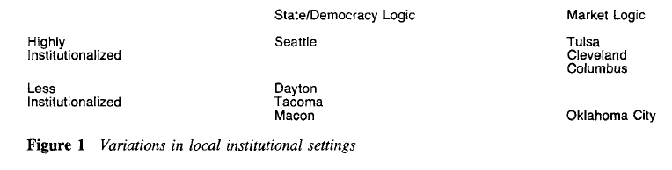
Step 2: Select Cases: Tulsa and Oklahoma City, OK; Dayton and Cleveland, OH; Macon and Columbus, GA; and Tacoma and Seattle, WA.
Criteria: each pair is located within the same state to minimize comparability problems;. Second, each pair was active in federal redevelopment programmes and suffered comparable cuts in federal aid during the 1980s. Third, previously incorporated minority and neighbourhood interests. Plus: Population size; difficult restructuring (de/re/industrialisation); metro-city governance disjunctures
Step 3: Build Analysis:
Notes:
Comparability problems: arising from interstate differences in state authorized spending, service responsibilities, legal municipal requirements and state policies and regulations
Results: reveals influence of changing federal funds; explaining tipping from one logic to another, e.g. with decline in federal funds (bureaucratic logic); off-budget governance leads to decline in neighbourhood groups influence (e.g. Cleveland); strong political leadership can sustain democratic institutionalisation (e.g. Seattle). Some lack institutional capacity (Oklahoma City)

Slide 17
Thinking with variation: Savitch and Kantor
“Our cities have been chosen because they illustrate a broad range of variation on variables that we believe are critical to urban development politics” (p. 23-24)
Democratic conditions
Competitive position
Intergovernmental environments
They don’t consider:
International influences e.g. neoliberalism
Diverse political system
Informality

Slide 18
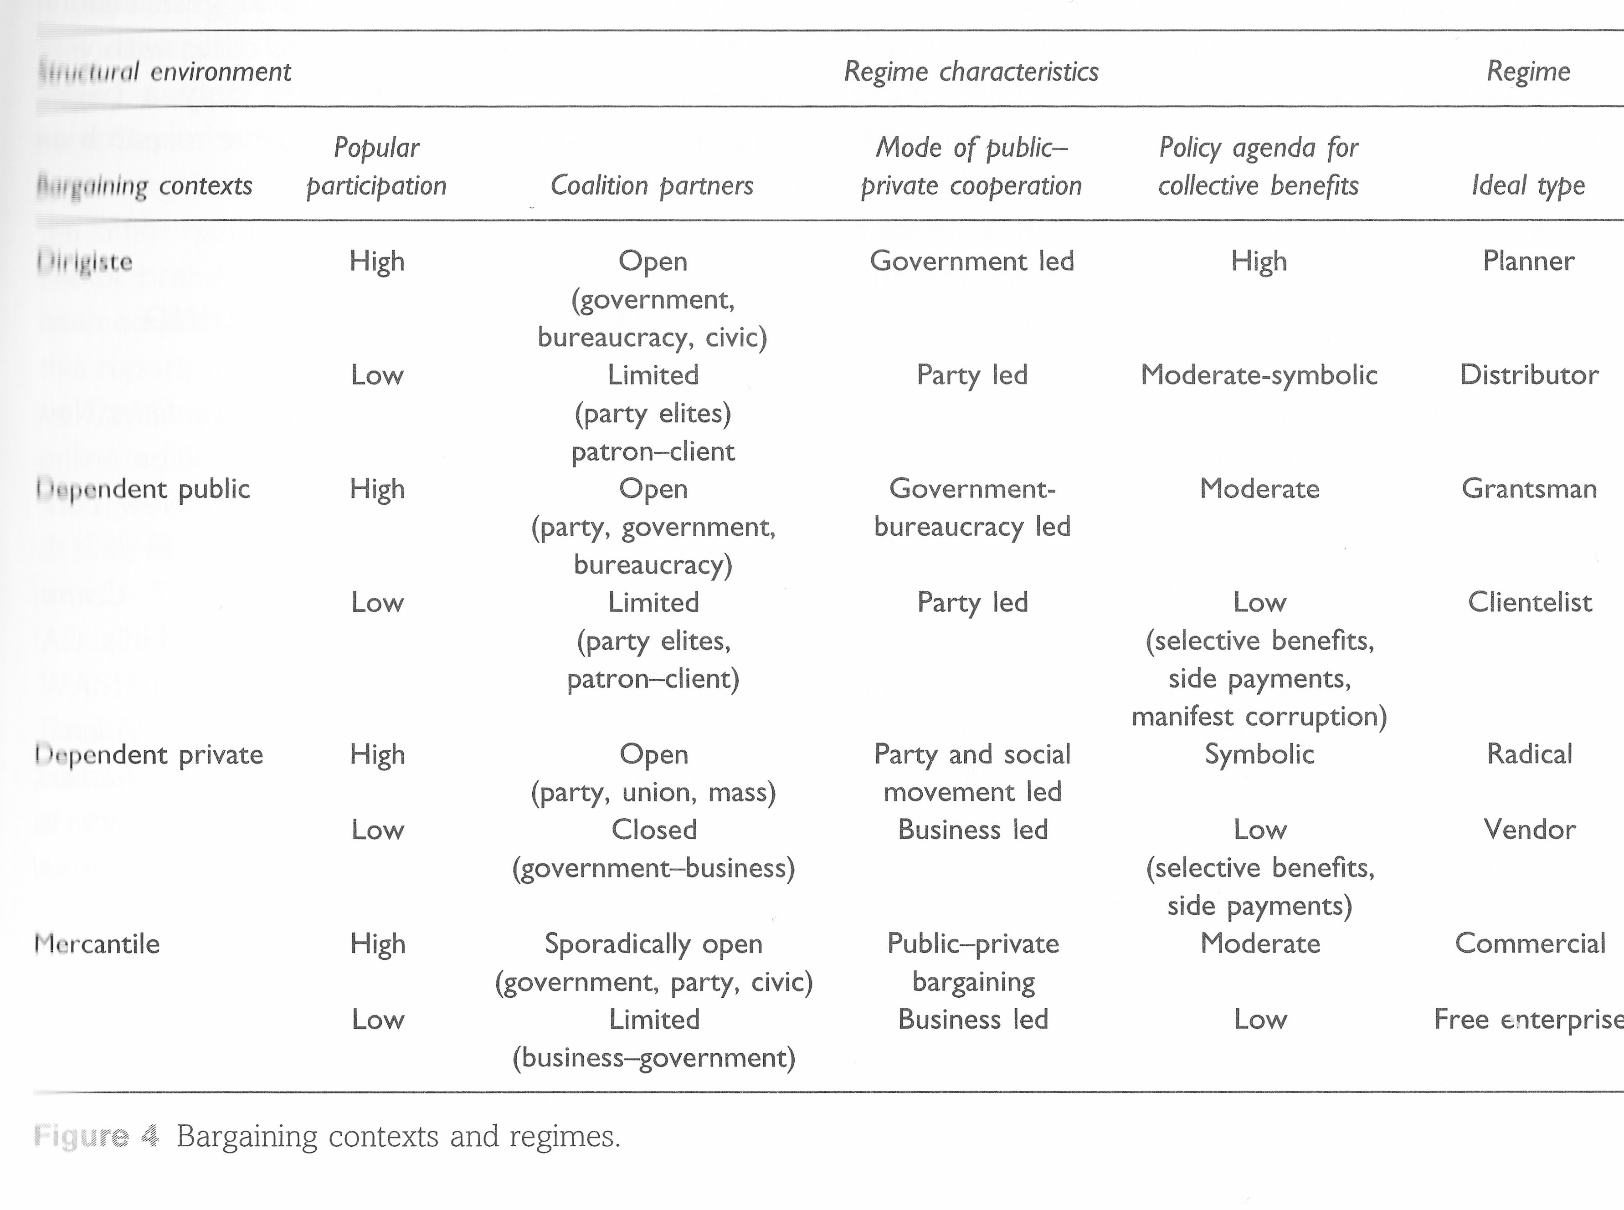

Slide 19
III – Experimenting with comparisons

Slide 20
What are comparisons useful for? Has focus on causal explanations obscured other ends (Krause, 2015)? Some other uses might be:
Better description
Delineating variety of a phenomenon
Sensitizing, critiquing and developing concepts
Building new concepts
Understanding particular cases is a comparative task
Thickening singularity
Critique – unsettling established/ethnocentric views of the world – it could be different…
Historicizing phenomena – conditions of possibility

Slide 21
Some (STS) ways to imagine comparative practice
Clinical trials – comparison as a race between two horses; method as devising the “race track” (Krause, 2015)
Method as “event”: Isabelle Stengers (2011, 49-50) insists that the achievement of “rapport” across different entities is singular, and “has the character of an “event rather than of a methodological enterprise”.
Assembling the comparator: “an assemblage that undertakes comparative work” (p. 2), including the individuals, technologies, institutions, settings, and comparative practices of others; authors “bounce around” their cases, “feeding the comparator” (p. 21). Comparison is not given in methods, or defined a priori, but is generated in the practices of working across different cases (Deville, Guggenheim and Hrdličková, 2015).
Thickening singularity: “Making comparators did not consist of extracting a few dimensions out of the singularity of each case but rather thickening its singularity in light of the other cases” (Akrich and Rabeharisoa, 2015)
Deville, Guggenheim and Hrdličková (eds) 2015. Practising Comparison, Mattering Press

Slide 22
Composing comparators
The politics of the “third term”
Beyond territorial and developmental assumptions
In practice, urban comparativists have: - identified shared features as basis for comparison
- developed new concepts by thinking with difference (not identified as basis for comparison!)
Devising the comparator over time

Slide 23
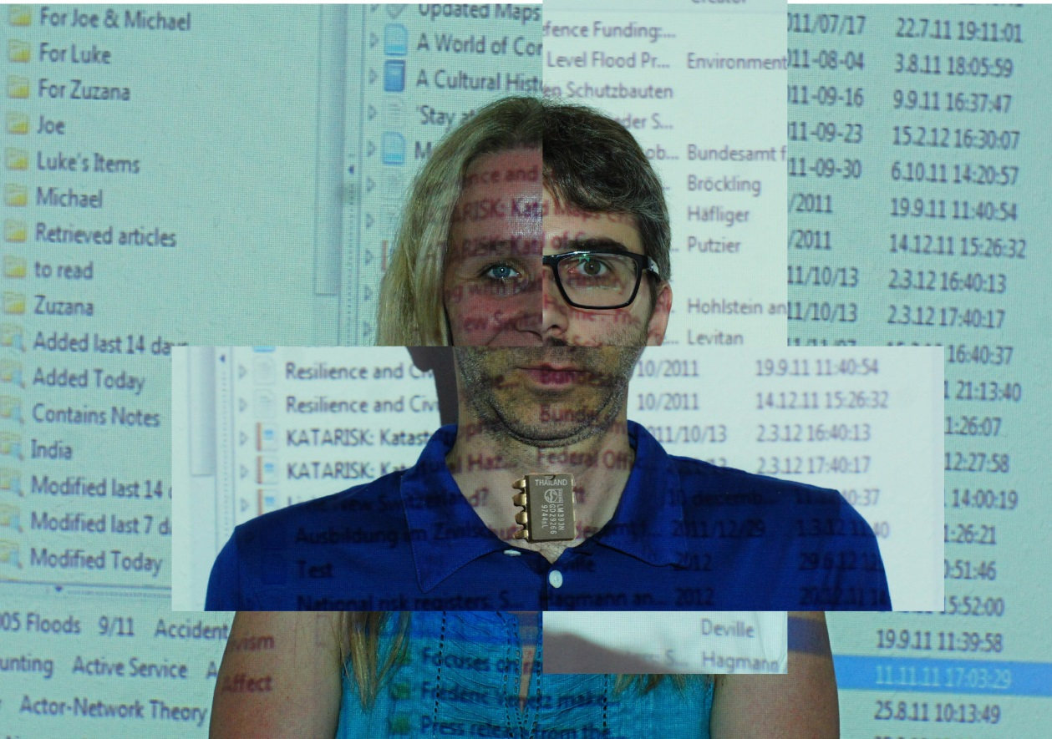
Assembling a comparator
Joe Deville, Michael Guggenheim, Zuzana Hrdličková

Slide 24
Type of Comparison | Features
The comparative gesture | Light touch referencing to different urban contexts
Cases in wider conversations | Detailed case studies with theoretical implications
Composing comparisons | Designing bespoke projects grounded in shared features, most similar/most different distinction not pertinent.
 | Repeated instances: urban phenomena with shared conditions of production
 | Unexpected comparisons
Tracing connections | Circulating practices leading to direct comparative reflections
 | Comparing connections
Launching analyses | Generating concepts in specific contexts, with possible wider applications
The limits of translation | Sui generis outcomes; distinctive meanings

Slide 25
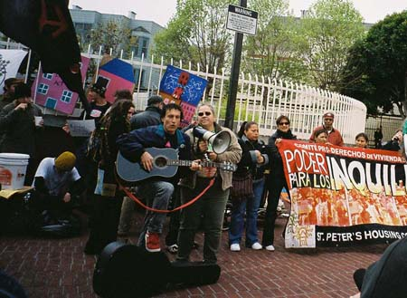
Unexpected comparisons (e.g. Roy, 2003; Myers, 2014)
“The American paradigm of propertied citizenship makes few concessions for the poor, turning the propertyless into the shelterless. In contrast, the Third World paradigm reflects the marginality of the poor, giving legitimacy to the shelter claims of the propertyless. Visiting the geopolitical context of American homelessness with this Third World paradigm in hand is thus immensely useful” (Roy, 2003, p. 473).
Notes:
http://mlyon01.wordpress.com/2007/04/08/homes-not-jails-occupies-house-left-vacant-by-real-estate-speculation/Homes not Jails 2007 San Francisco occupation

Slide 26
Relational Comparisons
Relational comparisons: ““away from searching for similarities and differences between two mutually exclusive contexts and instead towards relational comparisons that use different cities to pose questions of one another” (Ward, 2009, p. 10).
Relational comparisons: Gill Hart: Disabling Globalisation (2001): Taiwan to KwaZulu-Natal
Incorporating comparison (McMichael, 1990) “time and space are not uniform and cannot be abstracted from the construction of units and categories” (p. 395) i.e. Units (cities, parts of cities) exist in relation to wider social processes (connections, structures, systems) and they mutually shape each other
Topological Relationalities (John Allen, 2016): Attend to repetitions, imaginations, presences, proximities: Cities already inhabit one another, different elements of cities are already drawn into relationships with other cities (Malaquais, 2007)

Slide 27
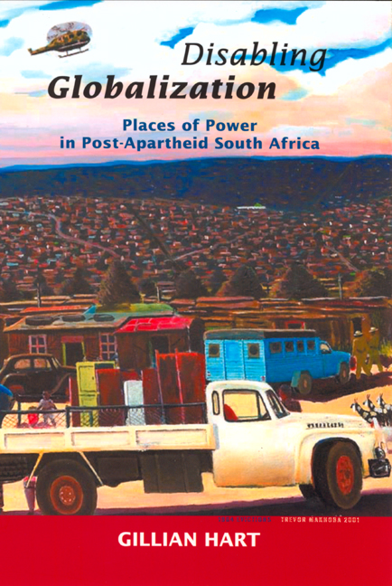
Relational Comparisons
We might draw analytical insights by considering cities through the specific shared connections which shape each, highlighting the impact of different histories and contexts. Gillian Hart (2003) pioneered this approach in her consideration of the effects of rural dispossession on small industrializing towns in northern KwaZulu-Natal, South Africa, through tracing the largely Taiwanese industrialists who chose to locate there in response to a late-apartheid industrial incentive scheme. Nik Theodore’s (2007) discussion of casual day labourers in the US, whose organising tactics are inspired by political experiences in various South American countries, provides another suggestive example of thinking comparatively with connections.

Slide 28

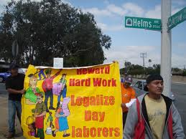
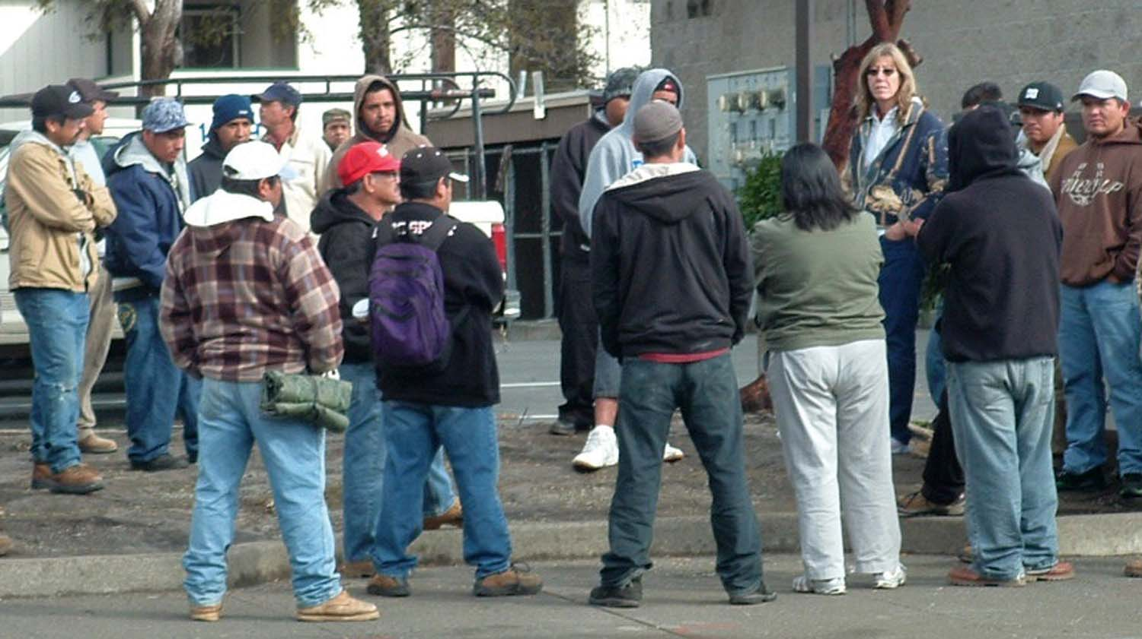
Pablo Alvarado, executive director of the National Day Laborer Organizing Network (and former popular educator in El Salvador) addresses the media on Aug. 9, 2006 in Chicago. The labor group NDLON signed an agreement to partner with the AFL-CIO in seeking improved working conditions and wages for illegal immigrants working in the U.S. (Tim Boyle (c) Getty Images)

Slide 29
“One of the things we respect most, and that’s why we’ve been successful organizing Latin American workers from different countries, are the workers’ ideological beliefs, their religion, their culture… we respect that… That is the interesting thing here – to put all the pieces together to create something different” (Oscar Paredes, founder and executive director of the Latin-American Workers Project in Brooklyn, NY, in Theodore, 2010, p. 14)

Slide 30
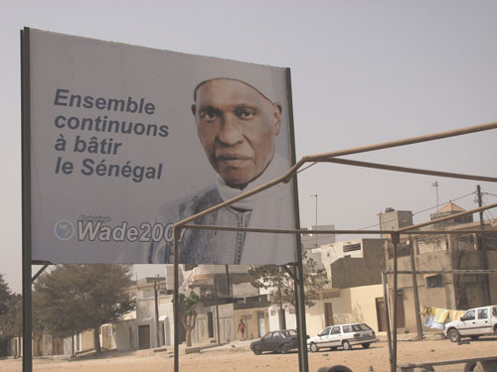
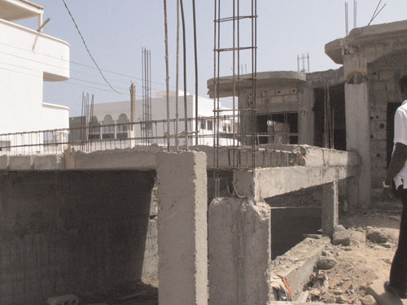
Home is where the heart abides (Sinatti): transnational connections
Notes:
FIGURE 2 A billboard erected by Wade’s reelection campaign proclaims, “Let’s continue to build
Senegal together.” (Melly, 2010, p. 42)

Slide 31
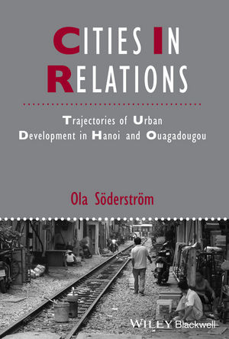
Comparing Connections
Trajectories of urban change:
Shared transition from Socialism to a
Liberal Economy
Hanoi: reinserted into Asian economic processes
Ougadougou: transnational political relatedness
oriented to Europe and North Africa

Slide 32
Peck and Theodore: Distended Case
The challenge here is one of traveling within cosmopolitan policy networks without becoming another creature of those networks; of making sense of fast-moving `best practices' without losing sight of prosaic practice; of taking account of phenomena like policy tourism and policy tradeshows without succumbing to explanatory dilettantism, or some kind of methodological ``tourism, [just] tripping around from site to site''

Slide 33
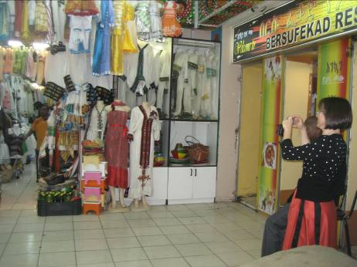
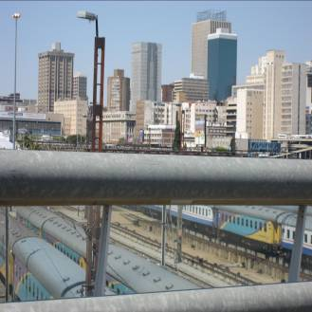
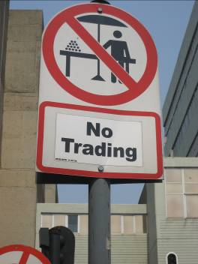
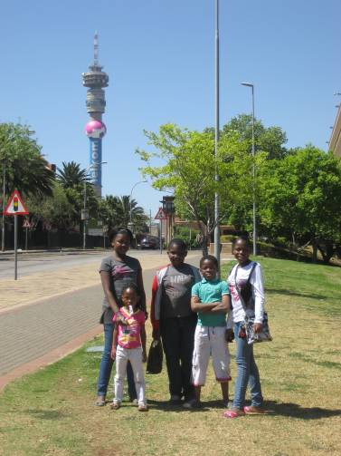
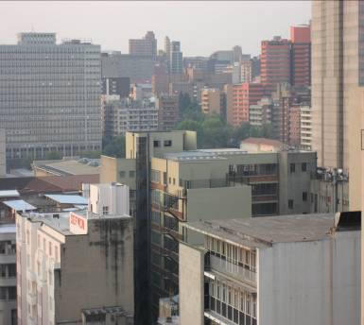
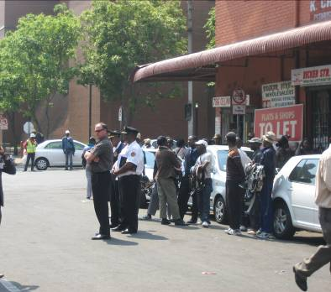
“embeddedness in multiple elsewheres” (Mbembe and Nutall, 2004)

Slide 34
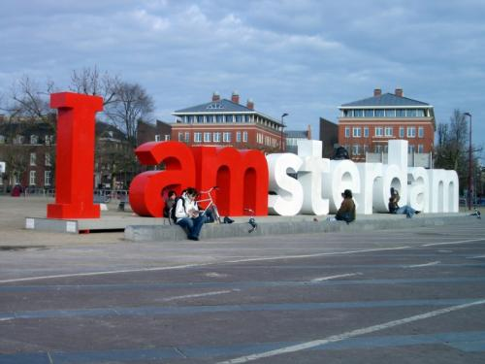
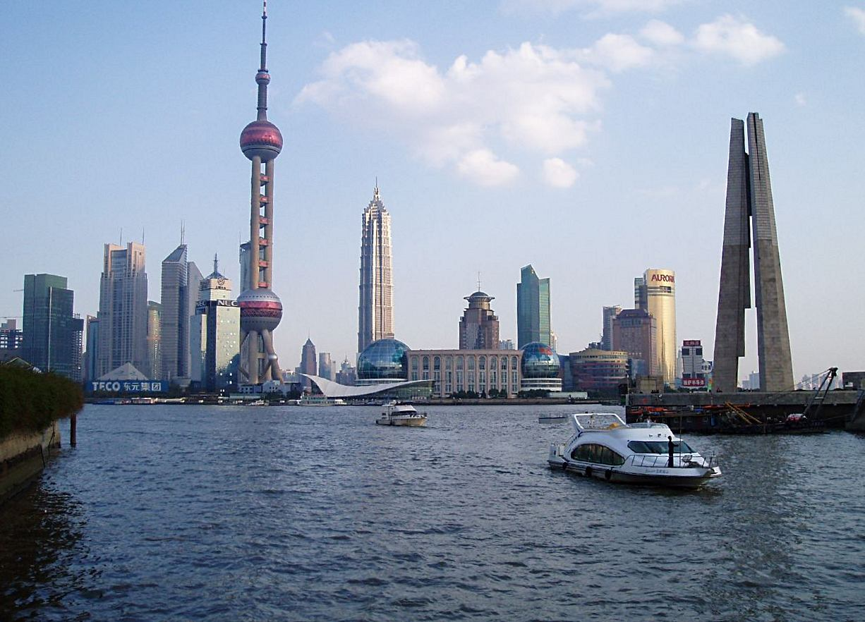
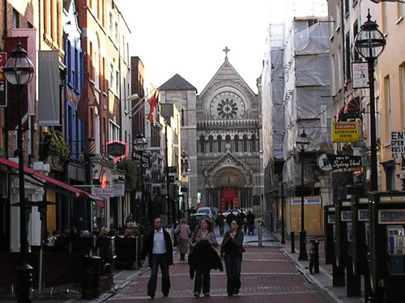
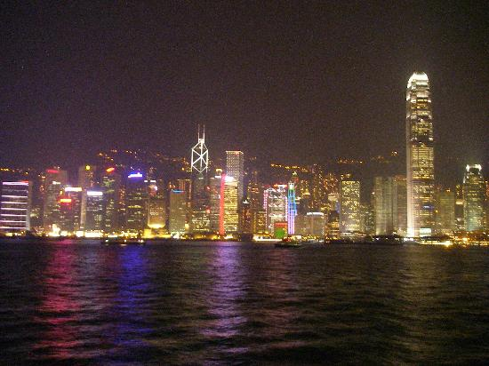
Thinking with elsewhere….Miami compared with:
Amsterdam: stable and peaceful business environment
Hong Kong: political refuge and hybrid cultural space
Shanghai: unruly city of foreigners and illegal activities as base for economic growth
Dublin: both vulnerable but unlike Dublin Miami is not a world city by design

Slide 35
IV Examples

Slide 36
Two demonstrations
Genetic: City Strategies
- Policy transfer (slow)
- Beyond neoliberalism
- Internationalising urban regime theory
Generative: Governing Large scale developments
Varieties of governance
Interspersed forms of power relations
Learning across difference

Slide 37
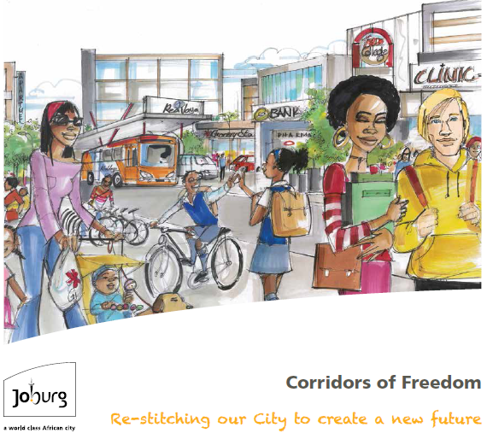
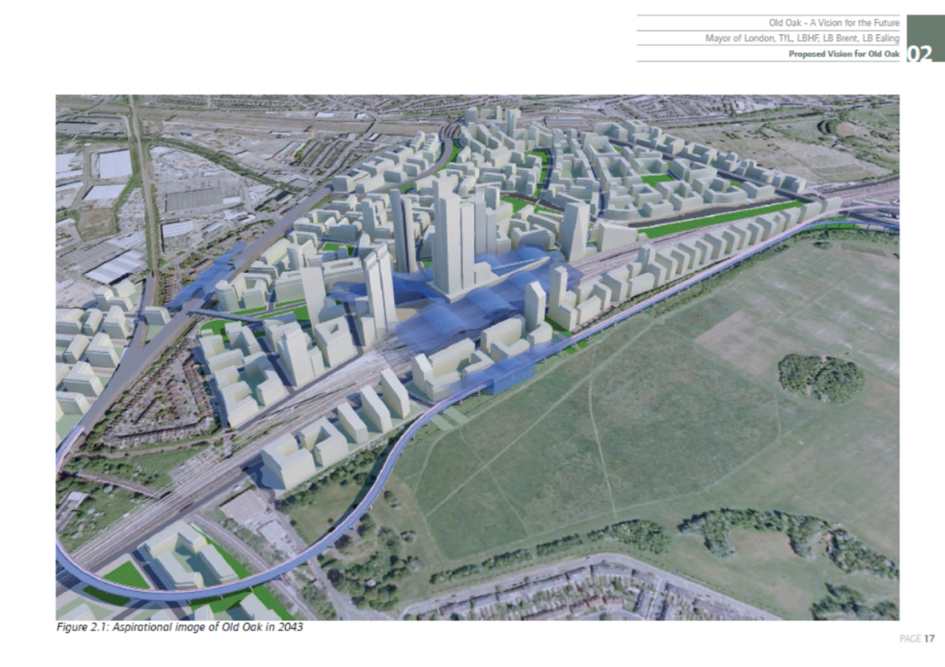
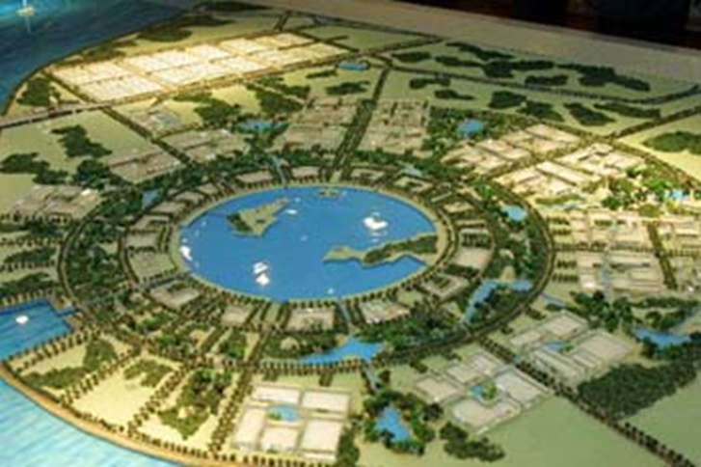
London as a Theory Destination
Learning from China?
Development pressure and urban imaginaries: what future for vernacular urbanisms?

Slide 38
 | Shanghai | Johannesburg | London
Creating developable land | Reclaiming land (low cost); relocation of residents; | Buying land parcels; investing in bulk infrastructure | Change land use; demarcate opportunity area
State actors | Multiple state agencies, with multiple roles, development corporations, different levels of government | Agile bureaucrats, planners, political support, integrated planning; building collective power | Local planners, central state and HS2, Mayoral Development Corporation, multiple state roles
State interests in development | Launch specific economic policy; recoup costs from land sales | Low income housing (gap market)/remaking urban form/leveraging BRT | Housing/growth/self-financing infrastructure
Financing model | State and DC investment; private sector land sales. Rent gap not needed? | BRT – some state support; metro property taxes; Development loan financing (France); private developers - minimize rent gap | Central state major infrastructure; Planning gain; TIFS? Land transfer? Maximise rent gap.
Wider agendas | Strategic economic planning | Developmentalism; policy speculation | Housing delivery; competitive world city status; infrastructure led growth model

Slide 39
1. Theoretical insights from China:
Growth coalitions, or, The Urbanization of the State
UK cities have always been a poor fit for “Growth coalition” theory (except perhaps London Mayor) without “local dependence” and close business-state links
Yet current massive expansion in local state dependence on property development
  Business rates
  Council tax payers
  Meeting housing targets for growing population
  Expanding income from land use and sale

Slide 40
“The local state does not necessarily “lead” the process of urbanization, but rather, the local state itself is urbanized” (p. 54)
“In short, the city and the local state are mutually constitutive. While local states build the city, the city builds the local state” (p. 212)

Slide 41
2. Empirical findings on the multiple roles of the State in large-scale urban development
“Our findings show that Lingang is characterised by a state driven top down initiative whereby the state has assumed multiple personalities as profit-conscious developers, market regulator and key investor . We particularly highlight the role of state owned development corporations who have to fulfil the political mission of creating a prosperous and populous Lingang whilst ensuring financial viability.” (Zheng Wang and Fullong Wu, forthcoming)
Also social provider and negotiating with residents

Slide 43
Territories of Exception:
Enterprise Zones to Development Corporations to Opportunity Areas
“. . .the answer [to the inner city crisis] might be to accept the fact. It would result in a final possible answer, which I would call the Freeport solution. This is essentially an essay in non-plan. Small, selected areas of inner cities would be simply thrown open to all kinds of initiative, with minimal control. In other words, we would aim to recreate the Hong Kong of the 1950s and 1960s inside inner Liverpool or inner Glasgow. (Hall, 1982: 417)
UDCs were “promoted as the perfect institutional vehicles for tackling ‘a wide range of complex land-use and assembly problems, which currently constrain housing and economic growth’ (ODPM, 2003b, p. 2) (Raco, 2005: 146)
“Cross-boundary connections and processes were downplayed as were the relationships between their development areas and the broader strategic planning frameworks in which they were embedded.” (Raco, 2005: 143)

Slide 44
Path dependency: Spaces of Exception

Slide 45
Notes:
Park Royal, “a strategically recognised west london development opportunity” Otherwise concentrated in East and Centre(Sept 1992. Strategic advice for London, Discussion Document) – post world city analyses; post Unitary development Plans review – a consistent view across the city.

Slide 46
Notes:
Towards a London Plan 2001:
Figure A demonstrates some of the interactions between transport, development and regeneration opportunities. Many of the proposed or agreed major public transport improvements, which will be carried out within the life of the London Plan, are shown. Four regional corridors, including the Thames Gateway, are also indicated, which are expected to be a focus for change. The broad characteristics of these corridors are identified. Some potential opportunity areas are also shown, most of which are brownfield sites. Of these, Stratford is seen as particularly significant. A number of town centres are illustrated, some of which coincide with proposed major transport improvements. (p. 11)

Slide 47
Notes:
2004 London Plan, p. 40

Slide 48
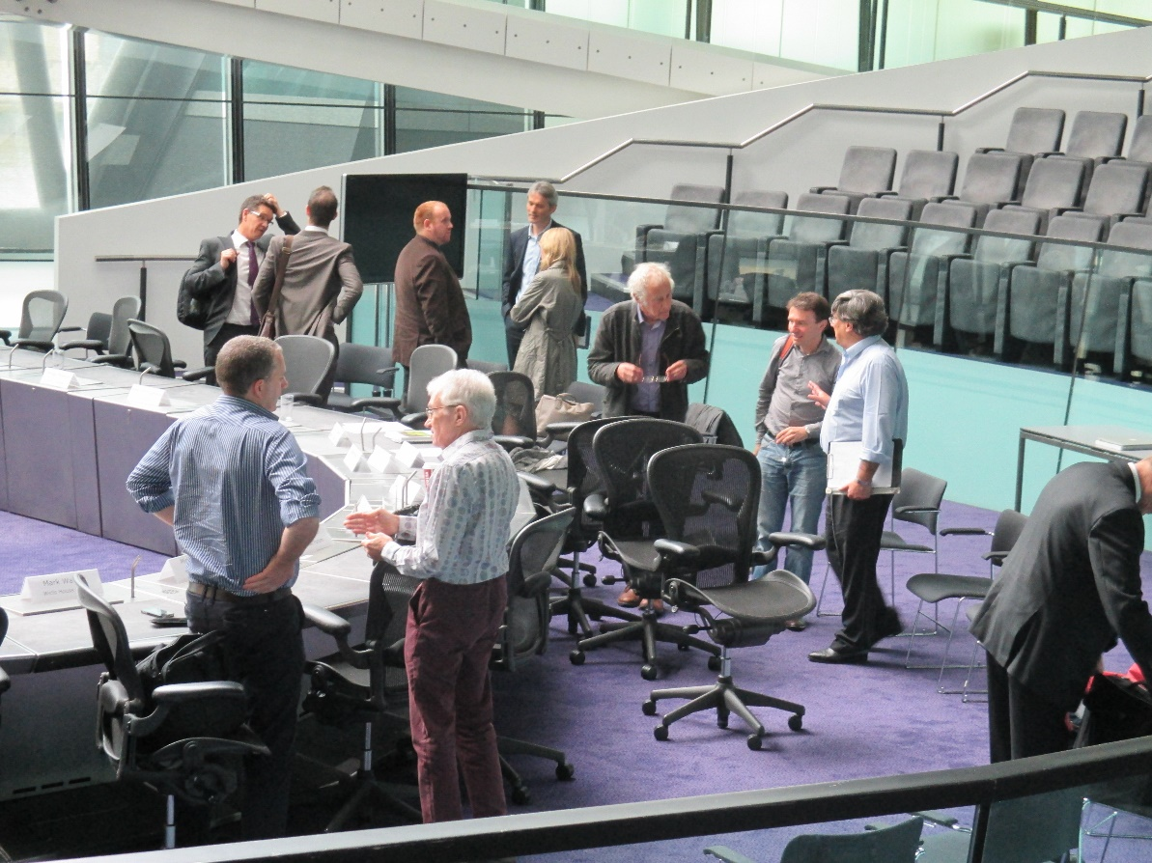
Opportunity Areas are key sources of housing supply in London. They are, by their nature, complex to bring forward and often require significant investment in infrastructure. (Mayor of London: 2016, p. 37)
To ensure that housing output is optimised … the scope for larger areas to determine their own character should be fully realised in terms of housing densities, including those towards the top of the relevant density scale where appropriate. It is essential that a good quality residential environment and public realm is secured in these areas. (FALP, 2014, p. 62)
Notes:
Homes for all Londoners (2016)
3.55 Opportunity Areas are key sources of housing supply in London. They are, by
their nature, complex to bring forward and often require significant investment in
infrastructure. They are also of a scale that can create fundamentally new places
and communities. Significant research and an in-depth understanding of the area,
its strengths and weaknesses, and how to deliver a successful place underpin the
development of an Opportunity Area Framework.
3.56 In these circumstances LPAs are encouraged to consider a more bespoke
approach to affordable housing taking account the nature of the specific sites. In
particular, LPAs may want to consider applying a fixed percentage affordable housing
target for Opportunity Areas and Housing Zones, and consider what affordable
housing products may be most suitable.
3.57 This approach could help provide certainty to developers and land owners
about the affordable housing requirements and help prevent land price rises
based on hope value. The percentage and mix of tenures should be based on an
understanding of the maximum reasonable amount of affordable housing based
on the specifics of that area (including social infrastructure, utilities and transport
requirements). (p. 37)

Slide 49
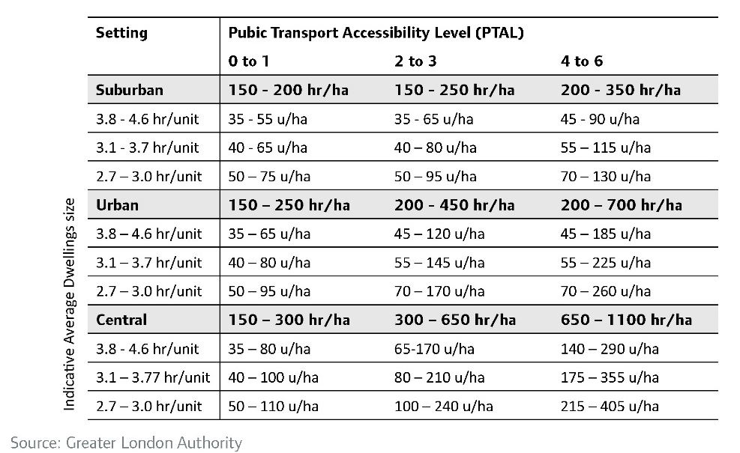
Notes:
Habitable rooms per hectare – OO achieving central London densities and heights 26-42 stories.

Slide 50
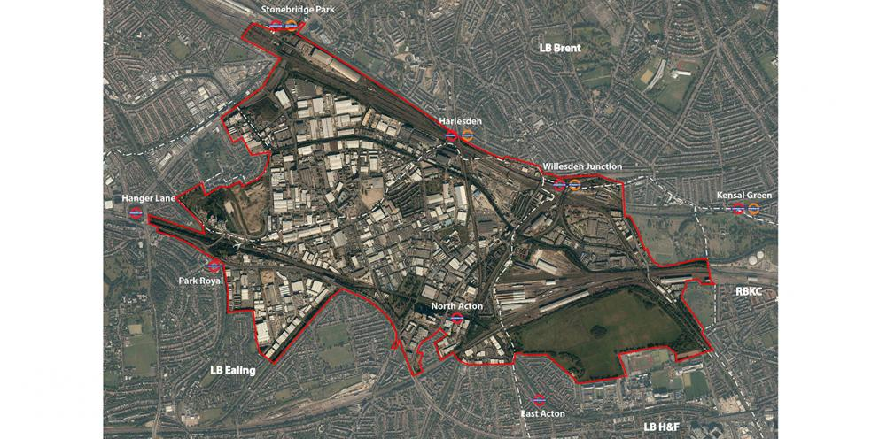
OLD OAK AND PARK ROYAL DEVELOPMENT CORPORATION
22000 houses, 55000 jobs
Infrastructure costs around £1.5bn

Slide 51
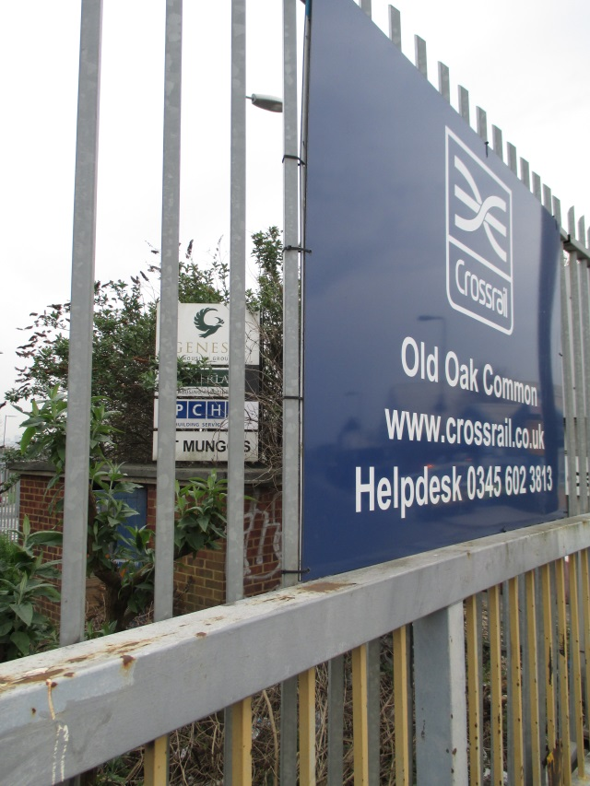
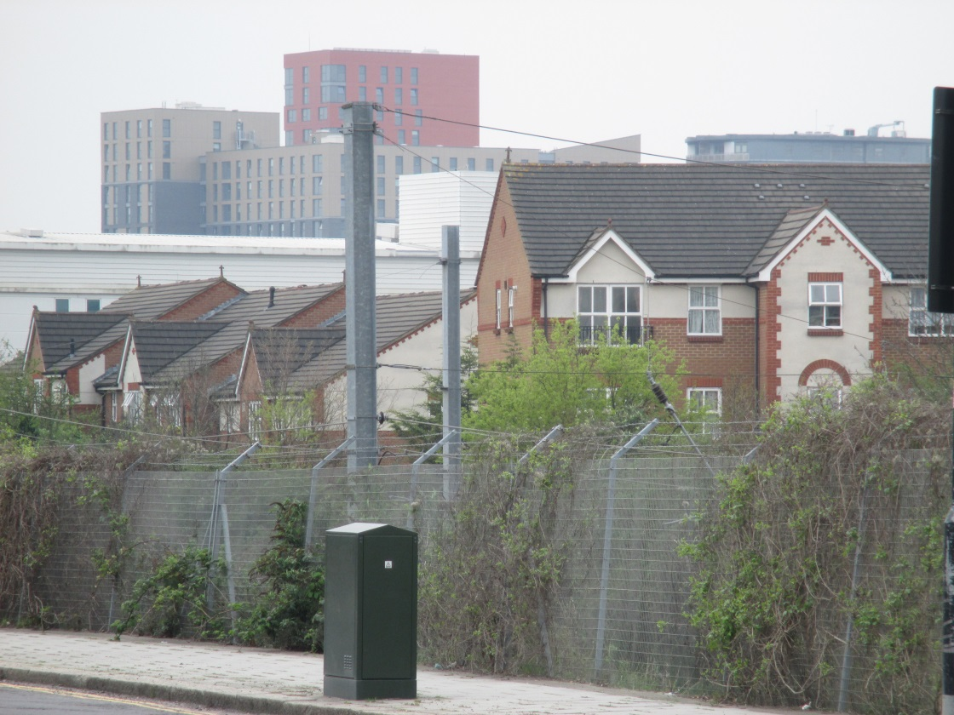

Slide 52
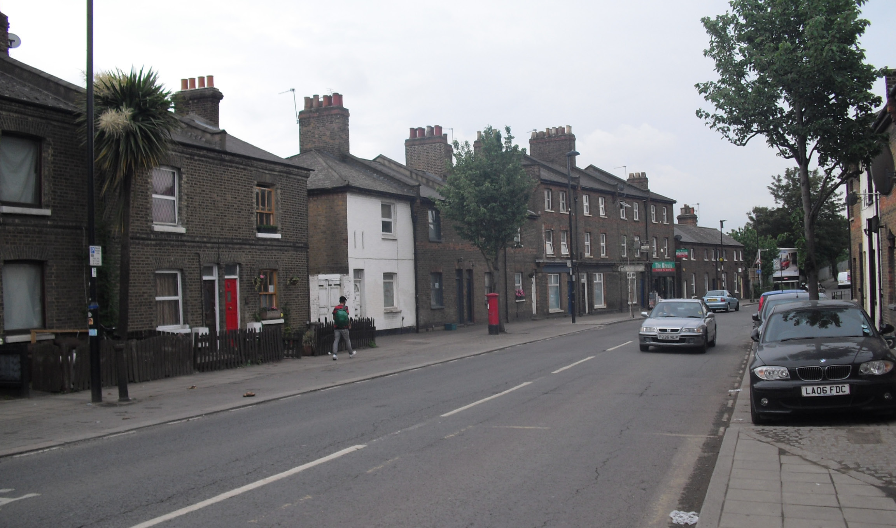
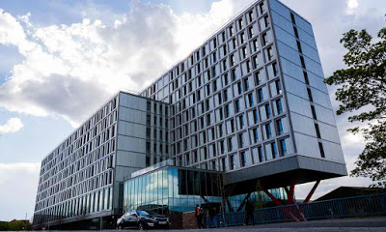
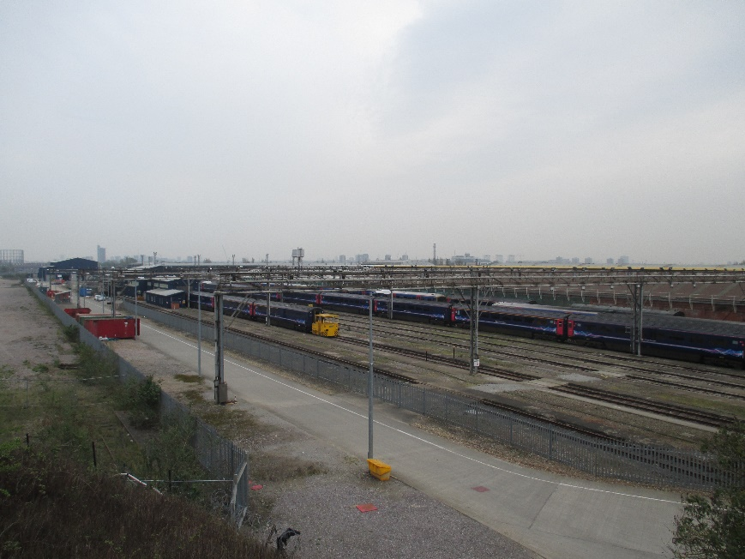
https://youtu.be/ClBj4RsBfe0
(minute 1.13)

Slide 53
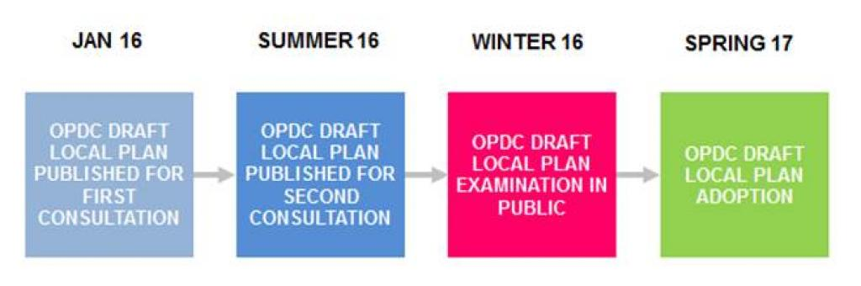
https://www.london.gov.uk/about-us/organisations-we-work/old-oak-and-park-royal-development-corporation-opdc

Slide 54

Notes:
Soft/sensitive edges vs the state as developer: maximise returns, ensure planning gain as “affordable” (shared ownership and 80% market rents; and limited social provision; push higher.

Slide 57
2.1 The funding for the infrastructure needed to bring forward development in the area amounts to approximately £2.5bn and Government expects this to be paid for from development.
2.2. The need for such a level of infrastructure will have an impact on the level of affordable housing that can be delivered within each development – and this will need to be recognised within individual planning applications. Without considered infrastructure investment, future developments will be unable to come forward and Old Oak will not work as a coherent whole.
2.3 Discussions with Government departments about gap funding or other financial contributions to reduce the impact of the infrastructure bill have so far proved fruitless. This is in the context of Ebbsfleet receiving £310m. And Birmingham has received £97m to extend its metro and enhance connections to and from the HS2 Curzon Street station. Birmingham is also benefitting from an expanded Enterprise Zone.
2.4 In addition to impacting on the ability of developments to provide an acceptable level of affordable housing, the high cost of infrastructure may force a quantum and scale of development that is unacceptable in height, scale, density or mass – and at the expense of community infrastructure.
GLA Review of OPDC (February 2017)

Slide 59
Genesis is a Housing Association that provides homes and high quality services for around 100,000 people. Its roots in West London date back to 1965 and it was established in response to the serious housing crisis that was gripping London then. Today, it supports a wide range of projects.

Slide 60
605 homes
•242 affordable homes (40%)
•61 (50% market) social rent
•61 (60-70% market) affordable rent
•120 intermediate (shared ownership) units
“An exhibition was held for local residents towards the end of 2015. The feedback was generally positive with residents welcoming the affordable housing contribution and mixed-use nature of the redevelopment. The main concerns raised were height and bulk and the management of the construction traffic. Overall, the feedback throughout the consultation has been positive and most
people recognise that the regeneration of the site is needed.”

Slide 61
“Could I just move on to density? The advice in the OAPF (Opportunity Area Planning Framework) was it should be lower densities on the sensitive edges of the opportunity area, with a maximum height of 8 to 11 storeys and this evening we hear that we got to have these wonderful entrance gates to the area of 26 storeys! Which policy are you advocating (moderator 5 min)? The one you came up with in your initial document or what you came up with now or are you bending over backwards for what the developers want.”
OPDC Planning Committee, 13 July 2016, resident, objector
The circulation of global capital…
Or, the Fragmentation of planning reason?
Public Interest Policy; Development Management; … and Developer

Slide 62
Interview with developer
Developer: every couple of weeks, there has been pre-application meetings with different elements of the GLA.
Interviewer: what happens in these meetings?
Developer: it’s a combination of things; sometimes it’s very technical. So sometimes it is about meeting their technical standards associated with, for example, with the amenity space or the daylight and sunlight that comes into the flats, which relates to design. But sometimes they also have an urban designer who provides advice on the design, which is more aesthetic, so that is a little more subjective , that bit can be more challenging, especially if you are in a time pressure situation”
“There were comments which were a combination of that with urban design, if you move the location of the tallest building at the back of the site, that would have a benefit. But actually the location of the towers were largely influenced in the end by the planners mostly…
“the density and the height, the planners had a massive impact on that.”

Slide 63
State as development agent: drawing in finance; shaping outcomes
“funding the infrastructure to underpin homes and jobs around the new station should not be considered ‘business as usual’ for London to be covered by existing funding streams.” (Mayoral review of OPDC)
“I think it would be challenging to be both determining planning applications and preparing them. There would be a conflict potentially at that point but I think one of the benefits of a mayoral corporation, you do bring together, you bring much more closely land and planning application functions together and people might say well is there a conflict there, well actually, the reality is we are all trying to, we are all working to deliver the mayor’s agenda.” (OPDC Planner)
“The potential changes in densities that were allowed under the London plan meant we were able to explore something a bit more ambitious in terms of densities. It’s an extremely high density scheme, 1500 people per ha or something like that. It’s comparable with other much more built-up areas of London but actually our initial discussions with the planners encouraged that and wanted it to make it as dense as possible. “ (Developer)

Slide 64
City (Development) Strategies
“spreading like wildfire across cities in the global South” (Pieterse, 2008, p. 74)
Can spatial strategies “hold concerns about distributive justice, environmental well-being and economic vitality in critical conjunction” (Healey, 2007, p. 32); a “public realm asset”?

Slide 65
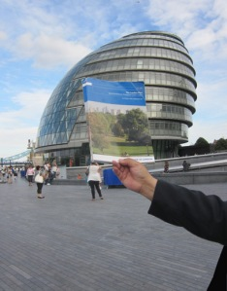
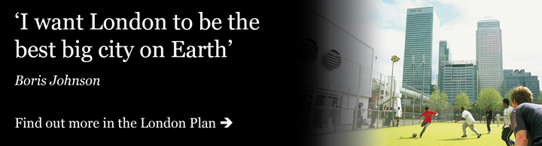
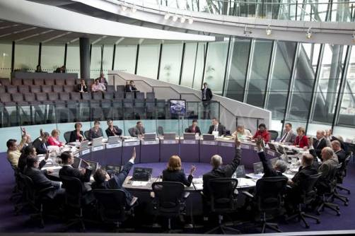
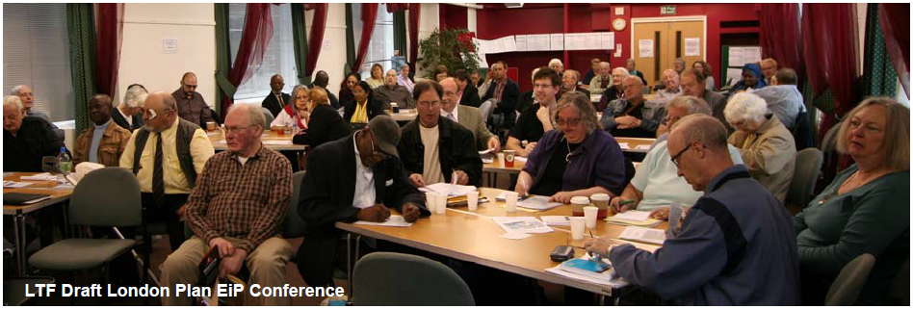

Slide 66
www.justspace.org
“For Just Space it was about making other voices heard within the metropolitan strategy, in particular the voices of groups directly affected by regeneration projects, whatever their ideological orientation” (Martine Drozdz, 2014; p. 425).
“In one workshop a tenants’ definition of a Lifetime Neighbourhood was drawn up—specifically aimed at influencing London Plan policy. The definition is important because it uniquely includes a focus on resident empowerment. As a result of LTF’s involvement in the 2010 EiP, a summary of our definition is London Plan policy and it is referred to as a case study in a 2011 government report on Lifetime Neighbourhoods.” (Sharon Hayward in Lipietz, (City), 2011, p. 216).
“And then there is the fact that there is an arbiter; the planning inspector is meant to be independent, you can appeal to him/her. Here you have a framework that, in theory anyway, seeks to ensure some equality between participants. Of course it’s not that straightforward but one can keep on appealing to the justice of the system. I think having this independent element is helpful.” (Richard Lee, ibid, 216).

Slide 67



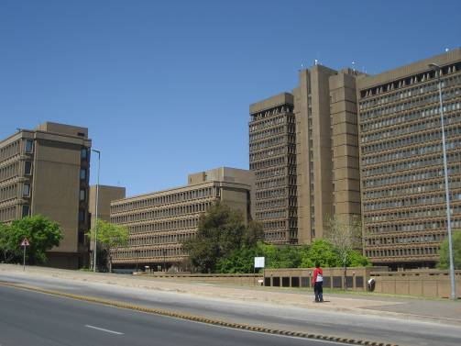
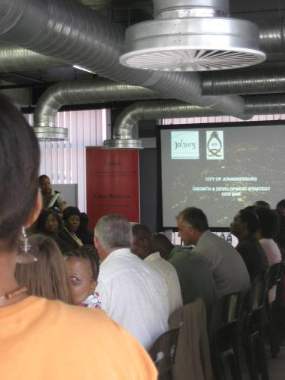
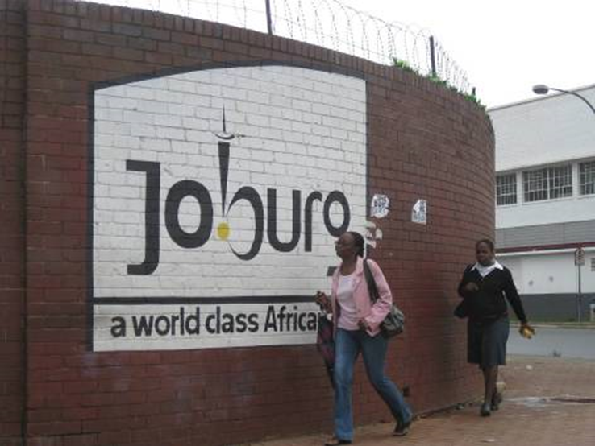
City strategies in Johannesburg
Notes:
Prof Jennifer Robinson has been researching Johannesburg’s long term city strategies for some time, following the process leading to the plans looking forward to 2010, 2030 and now 2040. Research questions include how the competing challenges of the post-apartheid city were navigated; how local and transnational policy ideas come together to shape policies; how different interest groups and actors influence the city strategy. Some of this material has been published with Prof Sue Parnell of the African Centre for Cities at UCT. A similar study has been conducted in Durban. Dr Barbara Lipietz of the DPU at UCL has also written on this topic in Johannesburg, especially on questions of public participation. Some publications by me include:
2006. (with Sue Parnell) Development and Urban Policy: Johannesburg’s City Development Strategy, Urban Studies 43, 2: 337-355
2007. (With Richard Ballard, Debby Bonnin and Thokazani Xaba) Development and new forms of democracy in Durban. Urban Forum. 18, 265-287. [Reversioned and translated for publication in French in Revue Tiers-Monde, edited special issue by Claire Bénit, 2008].
2008. Developing Ordinary Cities: City visioning processes in Durban and Johannesburg, Environment and Planning A 40, 74-87.

Slide 68


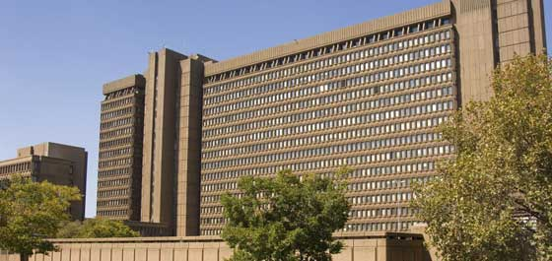

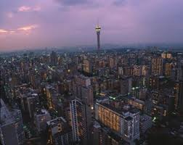




Slide 69
Notes:
Joburg GDS, 2006. Approach summarised, to the left are the 6 development paradigm principles

Slide 70

Notes:
United Cities March 2011

Slide 71

“it came out of nowhere”
networks, accidental meetings, slow policy transfer
Notes:
71

Slide 72
Johannesburg Officials on Lilongwe
“it’s a fragment of Johannesburg”
“its not Johannesburg, no highways….expensive properties/squatter community… not much different from SA”
“Qualifications but no experience”
“confirmed the quality of the land surveying”
“the bye-laws were in good order; implementation was the issue”
“everything was from SA, right down to toilet paper”
“can we learn from others, not copy or replicate”
“people had to confess”
“they did have a municipal inspectorate under one umbrella, it was a good lesson for Johannesburg
“you have got stable cities in Johannesburg, Tshwane and Erkhurhuleni, but what happens if you’ve got poor governance, a poorly functioning city, no service delivery, collapse of service delivery, rampant corruption and all of those things, and you have that level of urbanisation, then what happens, it is a major problem”.

Slide 73
Thinking with informality
A spectral local state in Lilongwe:
bye-laws; filing systems; training officials
Remnant planning guidance in London;
Soft consultation and shaping participation
platforms
Proliferating civil society organisation and
mobilisation in Johannesburg

Slide 74
Dispersing “informality”
People as infrastructure
The unknowability of large, complex cities
Emergent social forms
Cultural grounds of state practices
Embedded institutional cultures
Bureaucratic discretion; street level bureaucrats
Spectral states (present-not active/ghostly-absent)
Legal voids; legal theft of urban politics
Personalised states; bargained authoritarianism
Flexible deals; uncertainty
Insecure, casualised labour

Slide 75
Mr Anthony Thickett (Planning Inspector) on the London Plan:
Uncertainty of numbers: “This revision has been driven partly by the realisation that the population of London has grown much faster than was anticipated in the 2011 London Plan. However, the extent to which this unexpected level of growth is structural or cyclical is unknown as is the ability of the Plan’s existing strategies and philosophy to successfully accommodate the envisaged level of growth. In light of this a full review of the Plan will commence in 2015.”
“predicting levels of employment is not easy”
Lack of capacity to implement: “it is not enough to grant planning permissions, homes have to be built”
Lack of legislation on co-operation and region-wide planning:
“In my view, the Mayor needs to explore options beyond the existing philosophy of the London Plan. That may, in the absence of a wider regional strategy to assess the options for growth and to plan and co-ordinate that growth, include engaging local planning authorities beyond the GLA’s boundaries in discussions regarding the evolution of our capital city.“”
Notes:
Also, institutional cultures – Rydin et al. on different cultures of planning involved in London Plan making

Slide 76
CITY | THEME | URBAN TERRITORY | POLICY PROCESSES | ACTING GLOBALLY | NATURE OF LINKS
JOHANNESBURG | proactive absorption of the poor | Developmental State Citizenship and services Local – Provincial tensions | Policy circuits, local invention (SELF-REFERENCE); networking | Metropolis, corridors of freedom (SPECTRAL), C40, ambition(vs national and province) | Topological multiple
LONDON | The best big city in the world | (Post-)welfare state shapes practice and memory; democratic voids (SPECTRAL) | Global business voice; EU and nested legislative context | Project and property based development model. direct comparisons. Strong institutional | SELF-REFERENCE long duree strategy plans; disjuncture
LILONGWE | “a shared future” | Present but SPECTRAL state; has capacities and systems, not strong | International development agencies, networking, personal | China, award, collaboration, development, personal training | Slow policy transfer; SPECTRAL

Slide 77
Some example conclusions
Territories: the grounds of global agency; shaping the terms of engagement and nature of global links (beyond local dependence/global circuits); diversity of political processes
Multiplicity of globalisations: circuits of investment, models of development, policy circuits, developmental interventions, post-humanitarian barter

