Slide 1
Selective Inference
Yoav Benjamini
Tel Aviv University
Swiss summer school at Villars-sur-Ollon
September 1-4, 2018
Preparation Supported by European Research Council grant: PSARPS
www.replicability.tau.il

Slide 2
Outline
Current replicability problems in Science
Selective inference - the silent killer of replicability
Simultaneous inference
False Discovery Rate (FDR)
Tests and confidence intervals controlling FDR and FCR
Estimation and Model Selection
Conditional inference
Hierarchical families
Simultaneous over the selected

Slide 3
Collaborative research with many
Ruth Heller, Dani Yekutieli, Tzviel Frostig, Tel Aviv U
Marina Bogomolov, Technion
Jonathan Rosenblatt, Ben Gurion U
Philip Stark, Will Fithian, UC Berkeley
Chiara Sabatti, Assaf Weinstein, Stanford
Christine Peterson
Yotam Hechtlinger, Carnegie Mellon
ERC – Advanced Research Grant
Practical Statistical Approaches to Replicability Problems in Life Sciences (PSARPS)

Slide 4
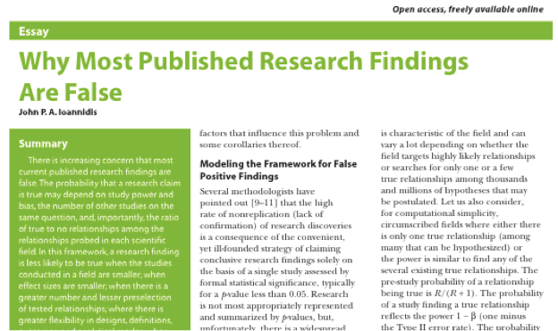

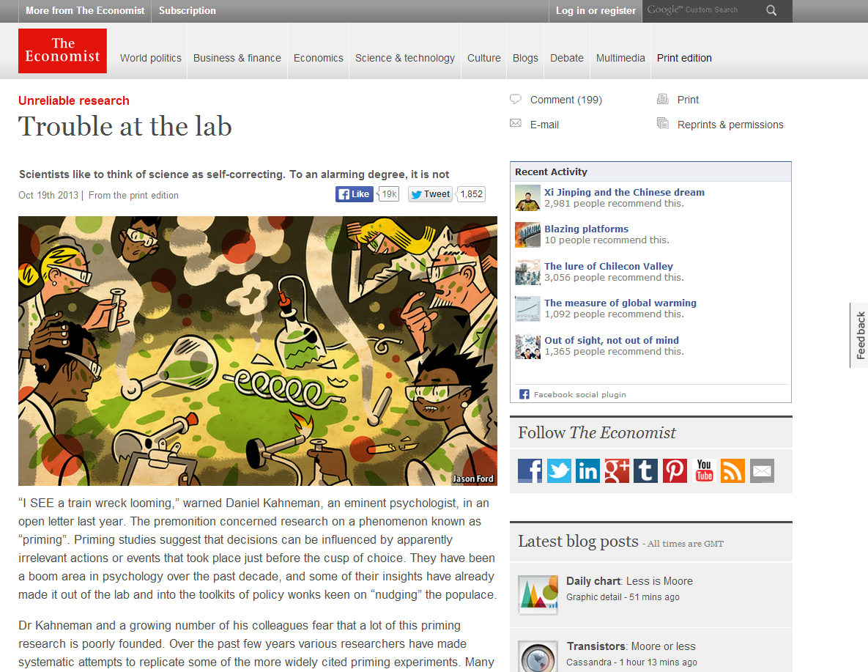
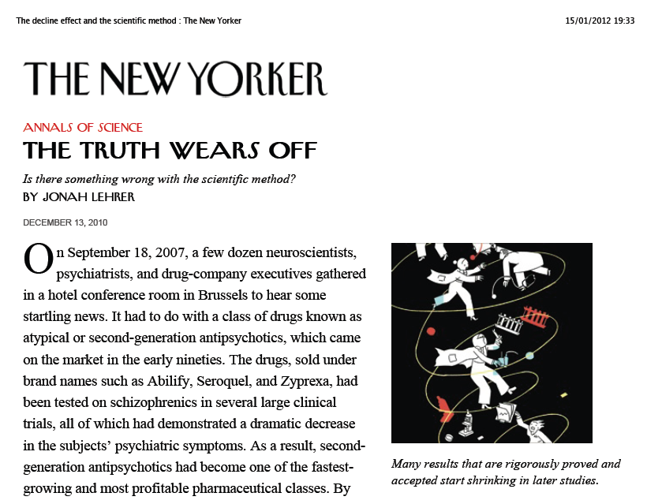
The replicability crisis

Slide 5
Replicability in Psychology
Replicability problems surfaced in experimental psychological
“Do normative scientific practices and incentive structures produce a biased body of research evidence in our field?”
Replication studies of 100 projects ended recently (Science 2015).

Slide 6
Replicability in science
The main principle protecting scientific discoveries is their being always subject to further scrutiny by other scientists: a discovery should be replicable
Goes back to the 17th century Robert Boyle, during his debate with Thomas Hobbs over his air pump and the nature of vacuum (Colin Baxter).
Boyle maintained that the foundations of knowledge should be constituted by experimentally produced facts. By repeating the same experiment over and over again, the certainty of fact will emerge.

Slide 7
Boyle and Huygens
The air pump was also complicated and expensive to build. “Huygens was the only natural philosopher in the 1660s who built an air-pump that was outside the direct management of Boyle and Hooke”.(Shapin & Schaffer )
When Huygens noticed a new effect while using his air pump,
  “it became clear that unless the phenomenon could be produced in England with one of the two pumps available, then no one in England would accept the claims Huygens had made…”.
.
Notes:
The effect noticed by Huygens was “anomalous suspension”, in which the water in glass cylinder above an air bubble was raised because of the vacuum inside the air-pump. Boyle couldn’t reproduce it at first because in his air-pump wasn’t completely water-tight. Shapin & Schaffer 1985, pp 239-249.

Slide 8

Replicability became the gold standard of science

Slide 9
Replicability with significance
“We may say that a phenomenon is experimentally demonstrable when we know how to conduct an experiment which will rarely fail to give us statistically significant results.”
Fisher (1935) “The Design of Experiments”.

Slide 10
“With a clean conscience” (Schnall et al ’08, Psy. Sc.)
Presented with 6 moral dilemmas and asked “how wrong each action was” : Does priming for cleanliness affect the response
1 Assessment of wrong-doing & 9 emotions rating per dilemma; Methods of priming verbal & physical (separate experiments) (m>84)
Results: No significant difference on any of the emotions in any of the experiments; only a contrast for disgust.
Each experiment barely significant on moral judgment over all dilemmas;
In 3 of the 6*2 particular dilemmas priming made a significant difference. All tests at 0.05;
Their Conclusion: The findings support the idea that moral judgment is affected by priming for cleanliness.
Expected number of errors if no effect at all >4
The replication study could not replicate these results.
Notes:
Eating dead dog
Switching Troley to kill one and avoid 5
Keeping money inside found valet
Plane Crash
False Resume
Kitten used for sexual arousal

Slide 11
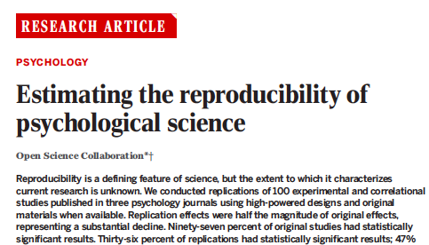
Fisher’s definition (significant in both) 36% replicated
Original effect in 95% CI of replication 47% replicated
(84% expected)
Meta-analysis of both 68% ‘replicated’
Comparison of effect sizes:
~ half in magnitude of the original effect sizes
But here the picture is more complicated

Slide 12
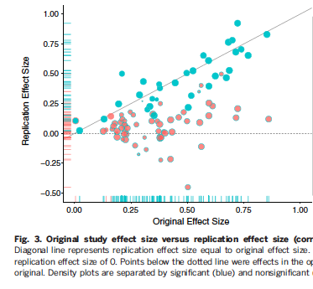
The only factor correlated with replication success is strength of evidence: effect size and p-value (not authors experience, institution, journal, area)

Slide 13
Reproducibility/Replicability
Reproduce the study: from the original data, through analysis, to get same figures and conclusions
Replicability of results: replicate the entire study, from enlisting subjects through collecting data, and analyzing the results, in a similar but not necessarily identical way, yet get essentially the same results.
(Biostatistics, Editorial 2010, Nature Editorial 2013, NSF 2015)
A confusion about terminology:
“ reproducibilty is the ability to replicate the results…”
in a paper on “reproducibility is not replicability”
We can therefore assure reproducibility of a single study
but only enhance its replicability

Slide 14
Enhancing Replicability
Replicability is a property of the study’s result across multiple studies.
What can be done at the level of the single study to increase its replicability?
Well and transparently designed experiment
Reproducible data analysis and computation
(Nature ’13, NIH in Nature ’14, Science ’14)
All agree that there is need for
Statistical methodology that enhances replicability
But what is it?
What problems should it address?

Slide 15
It’s the p-values’ fault
Psychological Science “… seeks to aid researchers in shifting from reliance on NHST … we have published a tutorial by Cumming (‘14), a leader in the new-statistics movement…”
9. Do not trust any p value.
10. Whenever possible, avoid using statistical significance or p-values; simply omit any mention of null hypothesis significance testing (NHST).
14. Prefer 95% CIs to SE bars. Routinely report 95% CIs…

Slide 16
Ban them!
Basic and Applied Social Psychology
Editorial by Trafimow & Marks Feb 24, 2015
“From now on, BASP is banning the NHSTP…prior to publication, authors will have to remove all vestiges of the NHSTP (p -values, t -values, F –values, statements about ‘‘significant’’ differences or lack thereof, and so on).
Eklund, A., Nichols, T. E. & Knutsson, H. Cluster failure: why fMRI inferences for spatial extent have inflated false-positive rates. Proc. Natl Acad. Sci. USA 113, 7900–7905 (2016).

Slide 17
Is it the p-values’ fault?
Given the concern about reproducibility,
and the attack on the p-value, a year long process started by ASA.
ASA Board’s statement about p-values (Am. Stat. 2016):
The p-value “can be useful” providing one approach to summarizing the incompatibility between a particular set of data and a proposed model for the data “ (Principle 1).

Slide 18
Is it the p-values’ fault?
Given the the attack on the p-value, a year long process started by American Statistical Association (ASA).
ASA Board’s statement about p-values (Am. Stat. 2016):
Opens: The p-value “can be useful”
Then comes: a list of “do not” ”is not” and “should not” “leads to distortion” – all warnings phrased about the p-value.
It concludes: “In view of the prevalent misuses of and misconceptions concerning p-values, some statisticians prefer to supplement or even replace p-values with other approaches. “
It’s the p-values’ fault!
“We’re finally starting to get rid of the p-value tyranny”

Slide 19
On the other hand:
Principle 2: “p-values do not measure the probability…“;
Principle 3: “scientific decisions should not be based only on whether a p-value passes a specific threshold” as this “..leads to considerable distortion of the scientific process”;
Principle 4: “P-values and related analyses should not be reported selectively”;
Principle 5: “A p-value, or statistical significance, does not measure the size of an effect or the importance of a result”
Principle 6: “…a p-value near 0.05 taken by itself offers only weak evidence against the null hypothesis”
All problems and warnings phrased in terms of p-values

Slide 20
ASA statement’s concludes with Other Approaches
“In view of the prevalent misuses of and misconceptions concerning p-values, some statisticians prefer to supplement or even replace p-values with other approaches. “
It’s the p-values’ fault!
Some responses to the statement
We’re finally starting to get rid of the p-value tyranny

Slide 21
Epidemiology: a p-values free zone

Slide 22
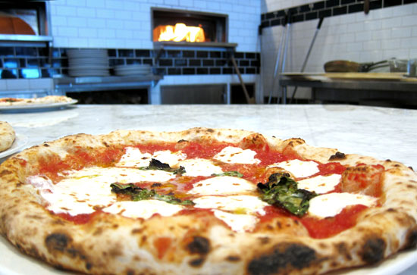
Epidemiology: a p-values free zone
Giovannucci et al. (1995) look for relationships between more than a hundred types of food intakes and the risk of prostate cancer
The abstract reports only three (marginal) 95% confidence intervals (CIs), apparently only for those relative risks whose CIs do not cover 1.
“Eat Ketchup and Pizza and avoid Prostate Cancer”

Slide 23
Is there something wrong with the scientific method?

Slide 24
It’s the selection’s fault
If selection is unattended for by appropriate statistical method
there is danger for lack of replicability
Ioannidis: ‘Why most research findings are false’
Essentially argues why the use of regular .05 testing
when selecting the significant findings from the many tested
has large proportion of false discoveries among the discoveries.
(also Soric, ‘89)

Slide 25
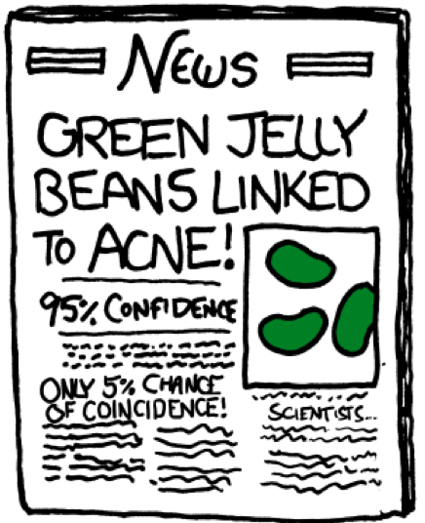
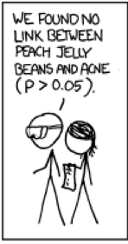
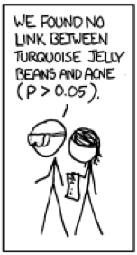
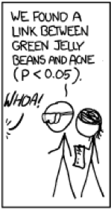
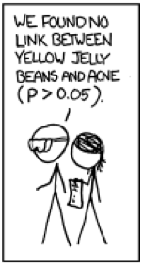
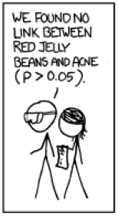
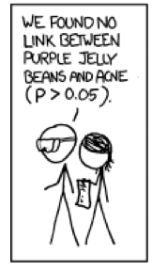
The lethal combination of the two
Scientists study rumours:
Eating coloured jelly beans causes Acne
xkcdSignificant.webarchive

Slide 26
Not only Jelly Beans
“Unussual secrets are hidden in numbers. for instance, an orange car is less likely to have serious damages that are discovered only after the purchase….”
Data mining from KAGGLE website
THE MARKER IT 2.5.2012

Slide 27
Influenza Vaccination in Pregnancy
Principle 4: Avoid selective reporting of p-values

Slide 28
Two main statistical obstacles to replicability
which are relevant to all statistical methods
Inference on the selected
Addressing the relevant variability

Slide 29
Selective inference
Inference on a selected subset of the parameters that turned out to be of interest after viewing the data!
How is selection manifested?
Out-of-study selection - not evident in the published work
File drawer problem / publication bias
The garden of forking paths
p-hacking (changing tests, removing ‘outliers’ …)
Inferactive Data Analysis

Slide 30
Selective inference
In-study selection - evident in the published work:
Selection by the Abstract, a Table, a Figure
Selection by highlighting those passing a threshold
Selection by modeling: AIC, C_{p}, BIC, LASSO,…

Slide 31
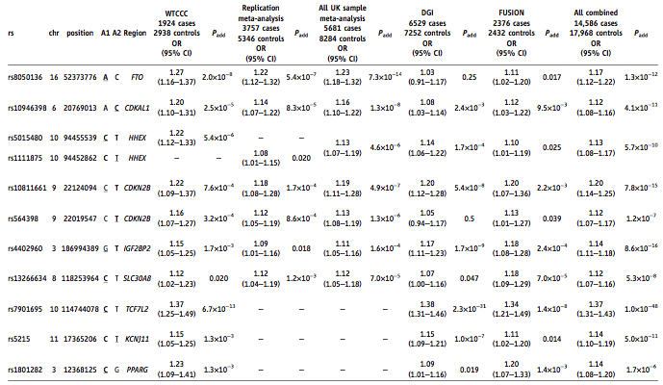
Selection by a Table
GWAS for type II Diabetics:11 selected by the table out of ~400,000

Slide 32
Selection by a Figure
Goal: Association between volume changes at voxels with genotype (Stein et al.’10)
1
Voxels searched
32,000
1
SNPs
number of tests ~ 13,000,000,000
448,000

Slide 33
In complex research problems
Selection is unavoidable!
Researcher are nowadays using lower levels as threshold for significance in order to control some error-rate
e.g: 5*10⁻⁸ in GWAS chosen so that FWER <.05, or FDR <.05
So we can maintain that
most of the selected findings will not be false !
In QTL analysis m>800 (1995)
In gene expression analysis m>4000 (2001)

Slide 34
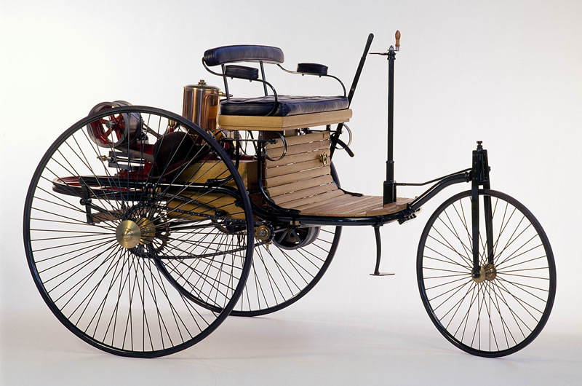



The industrialization of the scientific process
1888 1999
1950 2010

Slide 35
What about clinical trials
These enjoy complete transparency and clearly specified
population of study,
treatments’ regimes,
endpoints for efficacy,
endpoints for safety,
statistical methods pre-specified
familywise error-rate control

Slide 36
What about clinical trials?
Natalizumab, was examined by Ghosh et al (NEJM, 2003) for the treatment of Crohn’s disease.
Comparing 3 regimes with placebo; 4 measures of success;
at 5 time points; Total 51 endpoints
1 primary endpoint: Treatment by 2 infusions of 6mg/kg dose remission measured at week 6
Other 50 described as secondary endpoints
The result for the primary endpoint was not significant (p= 0.533);
27 secondary endpoints at p≤ 0.05 were considered as discoveries
Study reported as a success

Slide 37
Elsewhere? in medical research?
In depth analysis of 100 papers from the NEJM 2002-2010.
All had multiple endpoints (Cohen and YB ‘16)
# of endpoints in a paper 4-167 ; mean=27
In 80% the issue of multiplicity was entirely ignored: p ≤ 0.05 threshold (in none fully addressed.)
All studies designated primary endpoints (in 84% a single one)
Conclusions were based on other endpoints when the primary failed
The above reflects most of the published medical research,
but not the regulatory stage (Phase III trials).

Slide 38
In Experimental Psychology
Y Benjamini
Our analysis of the 100 in the Psychology reproducibility project:
# of inferences per study (4-700, average 72);
Only 11 (very very partially) addressed selection

Slide 39
Where did it all start?

Slide 40
The first data-mining problem in Statistics
Steel and Torrie (1960) bring from Erdman (1946):
6 groups of red clover plants,
inoculated with 6 strains of Rhizobium bacteria
5 measurements of Nitrogen content on each group.
Y_{ij}=μ_{ι}+ε_{ij} , ε_{ij} ~ N(0,σ²) i=1,2,…,6; j=1,2,…,5
( a standard textbook/manuals example)
Interest in comparing pairs of groups:
Estimates via difference of averages Y_{i’+} -Y_{i’’+}
Tests via two-sample normal tests or t-tests
What does it mean to have a result regarding a pair to be statistically significant at the .05 level?

Slide 41
The first data-mining problem in Statistics
Suppose we select the most promising groups’ difference Y_{(k+)} -Y₍₁₊₎
With the 6*5/2=15 such tests, each at level α
Prob( Y_{(k+)} -Y₍₁₊₎ ≥ σ_{diff}t_{1-α/2} ) > α
even if there is no difference
In fact going back to the original paper we found 13 such groups resulting in 13*12/2=78 pairwise comparisons. With the limiting computing power of the 40s a large scale inference problem was encountered.
The multiple comparisons problem (procedures) MCP

Slide 42
The 1st line of protection
Since the danger seems largest when μ₁=μ₂=…=μ_{k}
Test first this (single) hypothesis via F-test at level α.
  If not significant STOP
  If significant continue with t-tests at level α as before
This is Fisher’s protected LSD ( Least Significant Diff.)
The problem with this solution: protection is offered only when μ₁=μ₂=…=μ_{k}
Define such protection as the control of the
FamilyWise Error-Rate in the weak sense.
For a newer method that controls it see Donoho & Jin ‘04

Slide 43
Some notations before we continue
1. The null hypotheses tested: H₁,H₂,…,H_{m}.
m₀ of the m hypotheses tested are true,
we do not know which ones are true or even their number
2. The result of any testing procedure is R_{i} i=1,2,…,m:
R_{i}= 1 if H_{i} is rejected;
= 0 if not
Let V_{i} = 1 if R_{i}=1 but H_{i} is true (a type I error was made)
= 0 otherwise
3. R=ΣR_{i} # hypotheses rejected;
V= ΣV_{i} # hypotheses rejected in error
So, e.g.

Slide 44
Removing the “weak” : simultaneous inference
The FamilyWise Error-Rate
For any configuration of true and null hypotheses
FWER =Pr(V ≥ 1)
Thus by assuring FWER ≤ α, the probability of making even one type I error in the family, is controlled at level α:
Simultaneous Inference: all inference made from a family of hypotehses are jointly correct up to the pre-specified error
What about further selection from the rejected?

Slide 45
Same for Confidence Intervals
Estimate m parameters by a confidence interval for each. Define
V = # of intervals failing to cover their respective parameter.
If for any configuration of parameters
FWER =Prob(V ≥ 1) ≤ α
A set of such intervals is said to offer
Simultaneous Coverage at level 1-α

Slide 46
Old and trusted solutions
If we test each hypothesis separately at level α_{BON}
E(V)=E(ΣV_{i}) = Σ E(V_{i}) ≤ m₀ α_{BON} ≤ m α_{BON}
So to assure E(V)≤α we may use α_{BON} =α/m
(Is any condition needed? )
This is
(1) The Bonferroni simultaneous inference procedure
that controls the Per Family Error-Rate
For any configuration of hypotheses
Expected number of errors PFER= E(V) ≤ α
And therefore also FWER =Prob(V ≥ 1) ≤ E(V) ≤ α

Slide 47
Old and trusted solutions
If we test each hypothesis separately at level α_{BON}
E(V)=E(ΣV_{i}) = Σ E(V_{i}) ≤ m₀ α_{BON} ≤ m α_{BON}
So to assure E(V)≤α we may use α_{BON} =α/m
(1) The Bonferroni simultaneous inference procedure
E(V) = 0Pr(V=0)+1Pr(V=1)+2Pr(V=2)+…+mPr(V=m)
≥ 0 + 1Pr(V=1)+1Pr(V=2)+…+1Pr(V=m)
= 0 + Pr(V ≥ 1)
So, when using α_{BON} =α/m for individual tests, or for CIs
FWER =Prob(V ≥ 1) ≤ E(V) ≤ α
Is any condition needed?

Slide 48
More…
If the test statistics are independent,
and we test each hypothesis separately at level α_{SID}
Prob(V≥1)=1-Prob(V=0) = 1-(1- α_{SID})^{m0} ≤ 1-(1- α_{SID})^{m} ≤ α
(if m₀=m equalities). To assure Prob(V ≥ 1) ≤ α we may use
α_{SID} =1-(1-α)^{1/m}
(2) This is Sidak’s multiple testing procedure
Royen (2014) proved a long-standing conjecture:
If the tests are |T_{i}| > c , and T ~ N(0,Σ)
Sidak’ test is still conservative

Slide 49
Idea: we used dependency structure to get a better test.
How much better?
α_{SID} =1-(1-α)^{1/m}~1-(1- α/m - α²/2m) = α_{BON}+(α²/2m)(m-1)/m
Even for small m (=10) very little gain:
.00511 instead of .005
(3) Tukey’s procedure for pairwise comparisons:
Utilizes dependency by calculating the distribution of the studentized range statistics ( Y_{(k+)} -Y₍₁₊₎ )/(s/n^{1/2}),
same idea but larger gain
(known as the post-hoc analysis)

Slide 50
Newer solutions
Stepwise procedures that make use of observed p-values:
Let P_{i} be the observed p-value of the test for H_{i}
(4) Holm’s procedure: Always FWER ≤ α
Order the p-values P₍₁₎ ≤ P₍₂₎ ≤… P(k) ≤ P(k+1) ≤… P_{(m)}
Reject as long as ≤ ≤ ≤ > >
α/m α/(m-1) α/(m+1-k) α/(m-k) α
  Until for the first time P_{(k)} > α/(m+1-k), then stop
(5) Hochberg’s procedure: Positive dependence and ind.
Accept as long as
Until for the first time P_{(k)} ≤ α/(m+1-k), then stop and reject all k

Slide 51
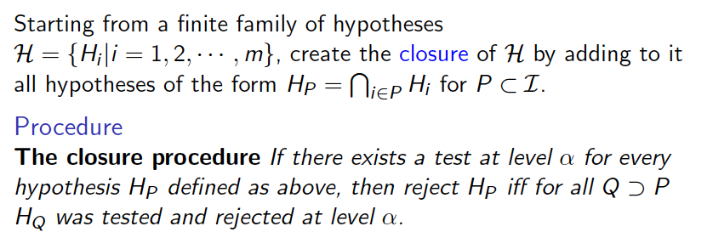

Both based onThe Closure Principle
    Marcus Peritz and Gabriel (1972)

Slide 52
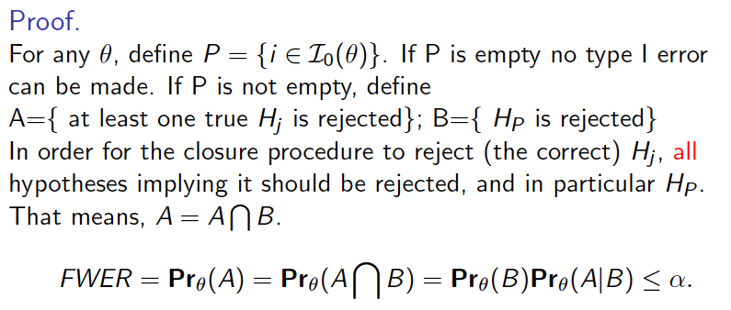

Slide 53
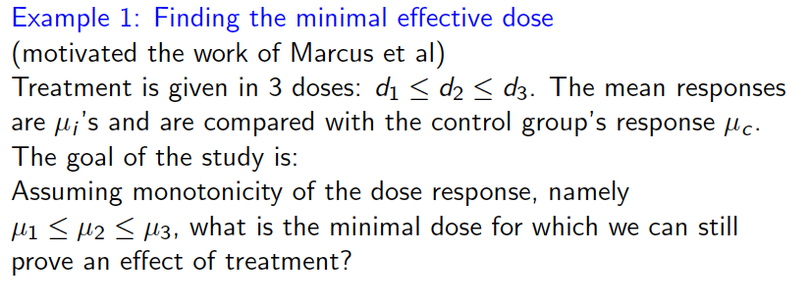
Coming out of the closure principle

Slide 54
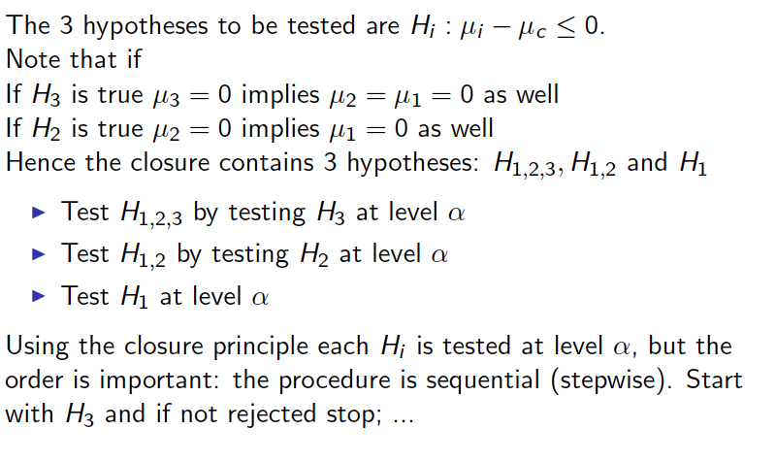

Slide 55
Coming out of the closure principle (more)
Using Bonferroni to test each intersection hypothesis => Holm’s procedure always controls FWER
Using Simes to test each intersection hypothesis =>
Hochberg’s procedure controls FWER
Hochberg’s (step-up) procedure
Order the p-values P₍₁₎ ≤ P₍₂₎ ≤…≤ P_{(m)}
  Starting with k=m compare each P_{(k)} to α/(m+1-k)
  Until for the first time P_{(k)} ≤ α/(m+1-k)
Then stop and reject H₍₁₎,…, H_{(k)}.
(Constants same as in Holm’s)

Slide 56
Recognizing a family
The familywise, per family, but what is a family?
A family should best be defined by the danger of selective or simultaneous inference that is being faced:
A family is
the smallest set of items of inference in an analysis,
from which any selection of results for presentation and highlighting could be made and be as useful.
Different researchers can have different goals and thus define differently the families – still decisions can be defendable and with no arbitrariness.

Slide 57
Recognizing a family
In a report of a clinical trial, not all hypotheses tested are a single family. There are at least 3 families:
Comparisons of baseline characteristics
Comparisons of endpoints capturing treatment effects
Comparisons of safety endpoint
A selected finding from one family cannot play the role of a finding from another family
Note: A family is not defined by the statistical dependency structure of the inferences.
We shall meet more families, and family of families, later today.

Slide 58
The implications of the choice of the family k=10; df=40 (n=5 per group)
The yardstick for significance at 0.05 once the comparison is divided by its standard error
All contrasts (Scheffe) 4.372
All pairwise (Tukey) 3.348
Comparisons with control (Dunnett) 2.812
Unadjusted (t-test) 2.021

Slide 59
The implications of the choice of the family k=10; df=40 (n=5 per group)
The yardstick for significance at 0.05 once the comparison is divided by its standard error
All contrasts (Scheffe) 4.372
POSI (Berk at al ‘14): All Projections of Y on subspaces of X
i.e. (X’_{s(x)}X_{s(x)})⁻¹X_{s(x)}’Y
-> family of the parameters of any linear model Y ~ X_{s(x)}, however selected, K(X,df)
All pairwise (Tukey) 3.348
Comparisons with control (Dunnett) 2.812
Unadjusted (t-test) 2.021

Slide 60
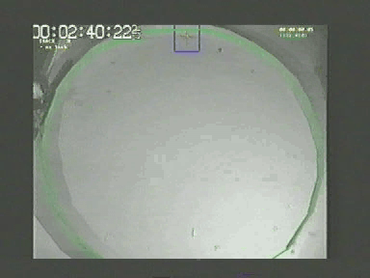
Example; exploratory behavior of mice
NIH: Phenotyping Mouse Behavior High throughput screening of mutant mice
Comparing between 8 inbred strains of mice
At 3 labs: Golani at TAU, Elmer MPRC, Kafkafi NIDA

Slide 61
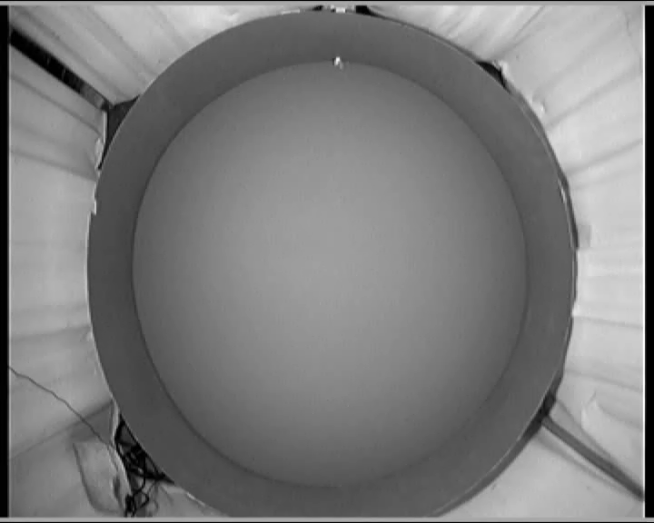

Slide 62


Slide 63
Significance of 8 Strain differences
Behavioral Endpoint | Mixed
Prop. Lingering Time | 0.0029
# Progression segments | 0.0068
Median Turn Radius (scaled) | 0.0092
Time away from wall | 0.0108
Distance traveled | 0.0144
Acceleration | 0.0146
# Excursions | 0.0178
Time to half max speed | 0.0204
Max speed wall segments | 0.0257
Median Turn rate | 0.0320
Spatial spread | 0.0388
Lingering mean speed | 0.0588
Homebase occupancy | 0.0712
# stops per excursion | 0.1202
Stop diversity | 0.1489
Length of progression segments | 0.5150
Activity decrease | 0.8875
Bonferroni
.05/17=.0029
Unadjusted

Slide 64
Better off with Confidence Intervals?
Tomatoes and Prostate Cancer
Giovannucci et al. (1995) look for relationships between more than 130 types of food intakes containing carotenoids and retinol, and the risk of prostate cancer
The abstract reports only the three (marginal) 95% confidence intervals (CIs), apparently only for those relative risks whose CIs do not cover 1.
“Eat Ketchup and Pizza and avoid Prostate Cancer”
No adjustment for simultaneous inference -
with Bonferroni none significant

Slide 65
But why care about simultaneous inference?
If a single null is true and tested at level α
on the average,
the proportion of times a type I error is made is α.
So why should we not worry only about the proportion
of times a test or a CI results in error ?
This property has is called The Per Comparison Error-Rate
where for any configuration of hypotheses
PCER= E(V/m)=E(V)/m
Testing at (nominal) level α assures per comparison level is α; amounts to “don’t worry – be happy” approach.
But when we select…

Slide 66
20 parameters to be estimated with 90% CIs
3/20 do not cover
3/4 CI do not cover
when selected
These so selected 4
will tend to fail,
or shrink back,
when replicated

Slide 67
Selective inference
This goal for selective inference is modest:
keep the original property of the individual inference to hold
on the average over the selected .
Selective inference for multiple confidence intervals:
average lack of coverage over the selected to be ≤ α.
The goal for simultaneous inference is more ambitious:
The property for individual inference should hold simultaneously for all parameters, and therefore simultaneously for any selected subset
simultaneous inference => selective inference

Slide 68
In the examples
Tomatoes and Prostate study
Selection into the abstract of the foods whose 95% CIs do not cover 1
Behavioral endpoints
Selection of endpoints whose strain differences are statistically significant
In these problems addressing the concern about selective inference should be enough

Slide 69
A predefined family of contrasts
Suppose we predefine a set of m contrasts on the k group means.
Find L_{1-α,C,k} so that
It can be done by numerical integration of (correlated) multivariatet-t , the matrix of contrasts C determining the correlation
See book by Bretz, Hothorn & Westfall and “multcomp” library in R.

Slide 70
The increasing scale of problems currently addressed
In 1978(?) Tukey writes that one should always prefer to control the FWER (simultaneous inference)
In 2000, Williams Johns and Tukey worked on a NISS project:
Results of Educational Progress assessed by testing
pairwise comparisons between 35 States in US
# of comparisons 35*(35-1)/2 = 595
There was a debate how to report results: with simultaneous pairwise adjustment or without.
Their suggested solution was selective inference via FDR control

Slide 71
A common feature of the larger applications
In these large problems:
The selected are presented, highlighted, discussed.
The strength of the result is displayed (p-values, effect size)
Those inferences that are not selected are simply ignored:
There are so many of them that even their identities are not reported, needless to say further details about the results of the inference for each

Slide 72
When is simultaneous inference needed?
1. Comparing a few alternative treatments with current practice treatment;
One of the statistically significant treatment will be chosen, based on effect size in combination with its side effects and price.
We need to protect the testing of all treatments effects
against any further selection from the selected
2. The set of primary endpoints in a clinical trial

Slide 73
References
Benjamini & Yekutieli (2005) ``False Discovery Rate controlling confidence intervals for selected parameters'’. JASA
Benjamini, Heller & Yekutieli (2009) ``Selective inference in complex research'’ Philosoph. Trans. of the Roy. Soc. A.
Donoho & Jin (2004) Higher criticism for detecting sparse heterogeneous mixtures , Annals of Statistics.
Giovannucci et al. (1995) INTAKE OF CAROTENOIDS AND RETINOL IN RELATION TO RISK OF PROSTATE-CANCER. Journ. National Cancer Inst.
Williams, Johns & Tukey (1999) Journal of Educational and Behavioral Statistics
Hsu () Multiple Comparison Procedures
Bretz, Hothorn, Westfall (2010) Multiple Comparisons Using R

