Slide 1
Selective Inference
Yoav Benjamini
Tel Aviv University
Swiss summer school at Villars-sur-Ollon
Lecture 2, September 3, 2018
Preparation Supported by European Research Council grant: PSARPS
www.replicability.tau.il

Slide 2
Outline
Current replicability problems in Science
Selective inference - the silent killer of replicability
Simultaneous inference
False Discovery Rate (FDR)
Tests and confidence intervals controlling FDR and FCR
Estimation and Model Selection
Conditional inference
Hierarchical families
Simultaneous over the selected

Slide 3
The False Discovery Rate (FDR) criterion
Benjamini and Hochberg (95)
R = # rejected hypotheses = # discoveries
V of these may be in error = # false discoveries
The error (type I) in the entire study is measured by
i.e. the proportion of false discoveries among the discoveries (0 if none found)
FDR = E(Q)
Does it make sense?

Slide 4
Does it make sense?
Inspecting 100 features:
2 false ones among 50 discovered - bearable
2 false ones among 4 discovered - unbearable
So this error rate is adaptive
The same argument holds when inspecting 10,000
So this error rate is scalable
If nothing is “real” controlling the FDR at level q guarantees
  Prob( V ≥ 1 ) = E( V/R ) = FDR ≤ q
  =>weak-FWER ≤ q
But otherwise
  Prob( V ≥ 1 ) ≥ FDR
So there is room for improving detection power

Slide 5
FDR controlling procedures – the BH
Benjamini-Hochberg 1995 (BH)
Let P_{i} be the observed p-value of the test for H_{i}
Order the p-values P₍₁₎ ≤ P₍₂₎ ≤…≤ P_{(m)}
Let
Reject
And in adjusted p-value form
and reject if p^{BH}_{(i)} ≤ q . These are now called q-values.
p^{BH}_{(i)} = min { p_{(j)}m/j, j ≥ I ; 1 }

Slide 6
Significance of 8 Strain
Behavioral Endpoint | Mixed | Linear StepUp
Prop. Lingering Time | 0.0029 | 0.0029 =.05(1/17)
# Progression segments | 0.0068 | 0.0058 =.05(2/17)
Median Turn Radius (scaled) | 0.0092 | 0.0088 =.05(3/17)
Time away from wall | 0.0108 | 0.0117 =.05(4/17)
Distance traveled | 0.0144 | 0.0147 =.05(5/17)
Acceleration | 0.0146 | 0.0176 =.05(6/17)
# Excursions | 0.0178 | 0.0205 =.05(7/17)
Time to half max speed | 0.0204 | 0.0235 =.05(8/17)
Max speed wall segments | 0.0257 | 0.0265 =.05(9/17)
Median Turn rate | 0.0320 | 0.0294 =.05(10/17)
Spatial spread | 0.0388 | 0.0323 =.05(11/17)
Lingering mean speed | 0.0588 | 0.0352 =.05(12/17)
Homebase occupancy | 0.0712 | 0.0382 =.05(13/17)
# stops per excursion | 0.1202 | 0.0411 =.05(14/17)
Stop diversity | 0.1489 | 0.0441=.05(15/17)
Length of progression segments | 0.5150 | 0.0470=.05(16/17)
Activity decrease | 0.8875 | 0.05 =.05(17/17)
17*p(i)/i
0.0493
0.0578
0.0521
0.0459
0.0490
0.0414
0.0432
0.0434
0.0485
0.0544
0.0600
0.0833
0.0931
0.1460
0.1688
0.5472
0.8875

Slide 7
The graphical way to look at it

Slide 8
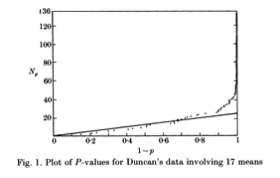
The background 1: Schweder & Spjotvoll (‘82)
“Plots of p-value to evaluate many tests simultaneously”
136 p-values
~25 true
Hochberg & BY (1989): Estimate m₀ algorithmically,
plug in Bonferroni’s & Hochberg’s methods instead of m

Slide 9
The background 2: Soriç’s paper JASA ‘89
Soriç argued forcefully against the usual way of 0.05 testing if many hypotheses are tested
Soriç identified that the problem faced is that of
Multiple Comparisons
He warned that “The proportion of false discoveries may be high”
Using E(V)/R ≤ 0.05*m/R
His conclusion was:
“There is danger that a large part of science is false”

Slide 10
Incidently, 16 years later
Does not mention Soriç, FDR, and not even multiple testing

Slide 11
The publication saga
The paper was first submitted to JASA 1989,
then Biometrika, finally appeared in 1995 in JRSS B
but after omitting the estimation of m₀
The original paper submitted to JASA then JBES 2000
Why such a struggle?
Users tried to avoid the loss of power involved in MCP
Multiple Comparisons was always (and still is)
a controversial issue
Suggesting that the FWER is not always needed –
was almost a betrayal

Slide 12


Slide 13
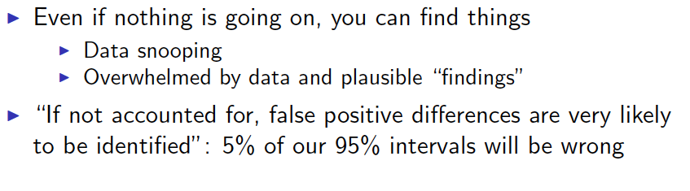
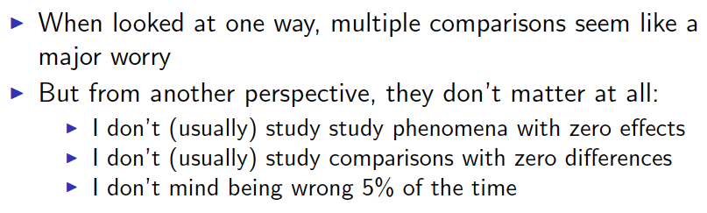

From Gelman’s talk

Slide 14
The dramatic change in attitude:
QTL Analysis
Microarray
Multiplicity
addressed
FDR
introduced
Micro-arrays
Multiplicity
addressed
Notes:
Should insert data from Rivka

Slide 15
“Genetic dissection of complex traits: guidelines for interpreting…” (Lander and Kruglyak, Nature Genetics ‘95)
“Adopting too lax a standard guarantees a burgeoning literature of false positive linkage claims, each with its own symbol… Scientific disciplines erode their credibility when substantial proportion of claims cannot be replicated…”
Note: Not that as a single claim cannot be replicated

Slide 16
Later reflections on goals
Yosi Hochberg (2001 Temple NSF conference), kept identifying “The problem of Multiple Comparisons” with “Selective and Simultaneous Inference” (attributing this point of view to Y. Putter)
Simultaneous inference: inference should hold jointly for all parameters in the family
Inference on the selected: Inference should hold for the selected parameters the same way it holds for each parameter separately
Traditional multiple comparison offered one set of tools to handle both concerns.
We now make a clear distinction between the two:

Slide 17
The Difference
Controlling FWER at level α in testing assures any selected test is also of level α.
Controlling the FDR at level α does not assure that!
Instead, just as marginal tests satisfy
FDR control assures control
that is on the average over the selected

Slide 18
FDR control of the Linear StepUp Procedure (BH)
If the test statistics are :
  Independent²
  independent and continuous¹
  Positive dependent one-sided²
  ¹YB&Hochberg (‘95) ²YB&Yekutieli (’01)

Slide 19
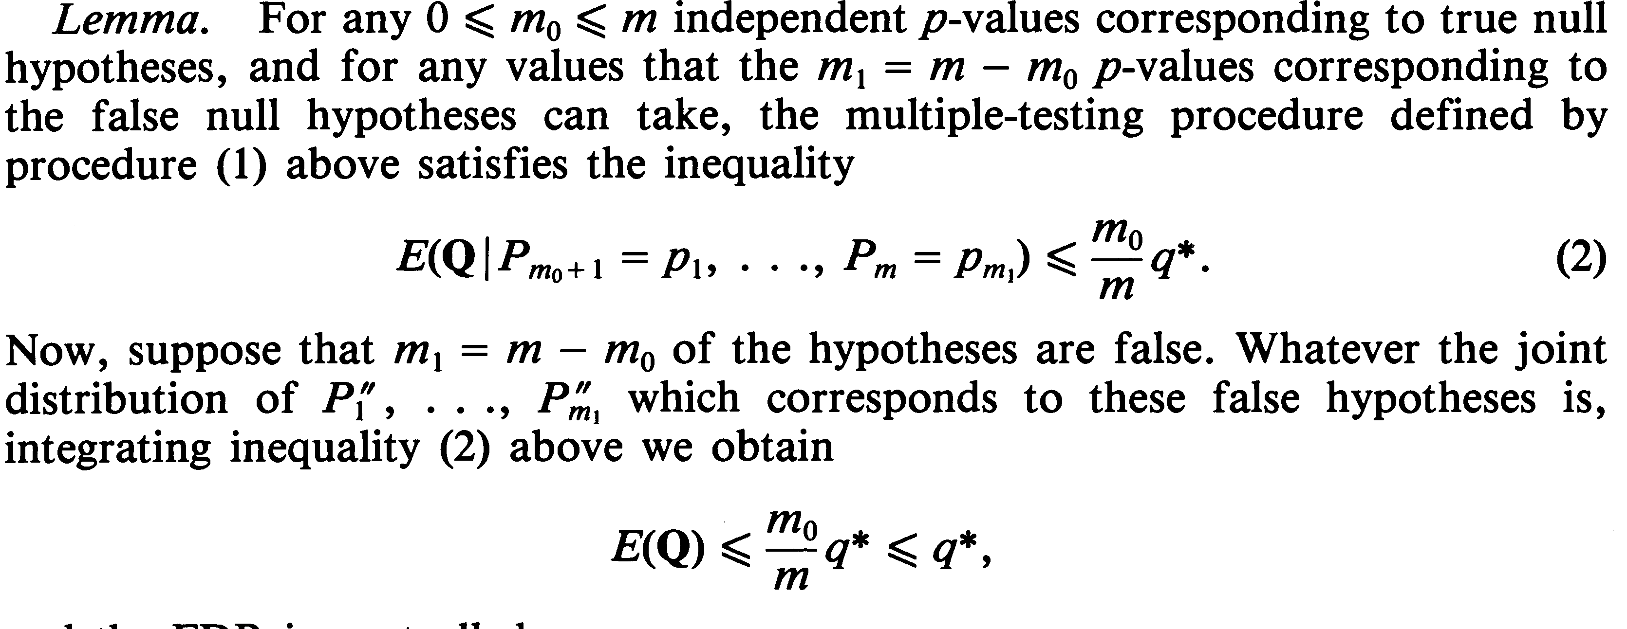
Proofs
The elegant proof: BH (1995)
The elegant proof: Storey, Siegmund & Taylor (’04)
using Martingale Theory

Slide 20
The work-horse proof of FDR in/equality
YB&Yekutieli (2001)
Denote
q_{k}=qk/m k=1,2,…,m
P_{0i} i=1,2,…m₀ correspond to the m₀ true null hypotheses
C^{(i)}_{k}= The values of all p-values other than i so that
if H_{i} is rejected exactly k hypotheses are rejected
Lemma:
E(Q)=Σ_{1≤i≤m0} Σ_{1≤k≤m} 1/k Prob(P_{0i} ≤ q_{k} & C^{(i)}_{k})
See also Ramdas et al (18+)

Slide 21
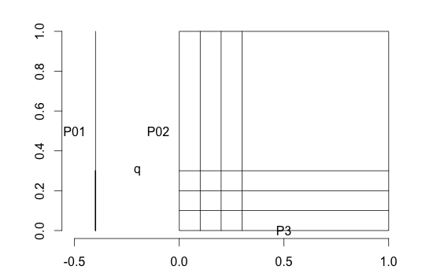

Slide 22
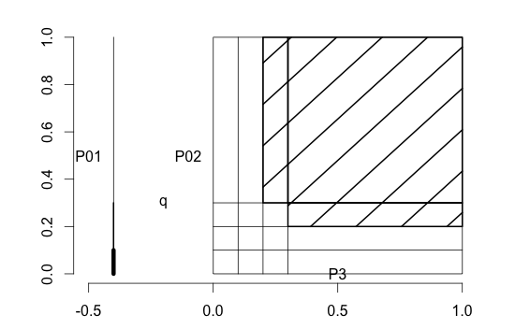
C₁⁽¹⁾
-- 1q/3

Slide 23
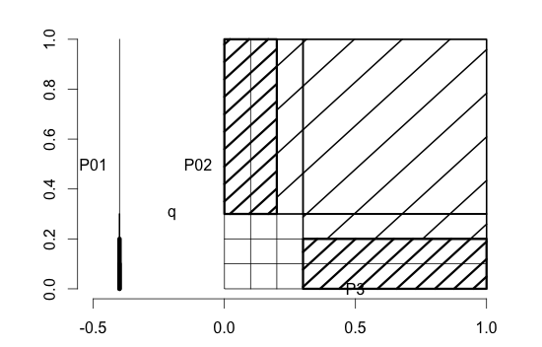
C₁⁽¹⁾
-- 2q/3
C₂⁽¹⁾

Slide 24
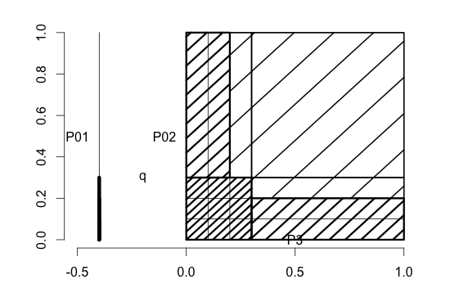
C₁⁽¹⁾
-- 3q/3
C₃⁽¹⁾
C₂⁽¹⁾

Slide 25
V/R=1/2
C₁⁽¹⁾
V/R=1/1
-- 3q/3
-- 2q/3
C₃⁽¹⁾
-- 1q/3
C₂⁽¹⁾
V/R=1/3

Slide 26
Proof of basic FDR equality
Theorem: If P_{i} ‘s are independent and continuous
E(Q)= Σ_{1≤i≤m0} Σ_{1≤k≤m} 1/k Pr(P_{0i} ≤ q_{k} & C^{(i)}_{k})
= Σ_{1≤i≤m0} Σ_{1≤k≤m} 1/k Pr(P_{0i} ≤ q_{k} ) Pr( C^{(i)}_{k})
= Σ_{1≤i≤m0} Σ_{1≤k≤m} 1/k qk/m Pr( C^{(i)}_{k})
= Σ_{1≤i≤m0} q/m Σ_{1≤k≤m} Pr( C^{(i)}_{k}) = Σ_{1≤i≤m0} q/m = qm₀/m

Slide 27
Positive dependency
Positive Regression Dependency on the Subset of true null hypotheses : YB&Yekutieli (‘01)
If the test statistics are X=(X₁,X₂,…,X_{m}):
  For any increasing set D, and H_{0i} true
  Prob( X in D | X_{i}=s ) is increasing in s
D
X₁
s’
s’’

Slide 28
Positive dependency
From half line generalize to an increasing set:
Positive regression dependency (Sarkar ‘69)
Positive regression dependency on a subset I₀

Slide 29
Proof of basic FDR inequality
Theorem: If P_{i} ‘s are continuous
E(Q)= Σ_{1≤i≤m0} Σ_{1≤k≤m} 1/k Pr(P_{0i} ≤ q_{k} & C^{(i)}_{k}) =
= Σ_{1≤i≤m0} Σ_{1≤k≤m} 1/k(qk/m) Pr(P_{0i} ≤ q_{k} & C^{(i)}_{k}) / q_{k} =

Slide 30
Proof of basic FDR inequality
Theorem: If P_{i} ‘s are continuous
E(Q)= Σ_{1≤i≤m0} Σ_{1≤k≤m} 1/k Pr(P_{0i} ≤ q_{k} & C^{(i)}_{k}) =
= Σ_{1≤i≤m0} Σ_{1≤k≤m} 1/k(qk/m) Pr(P_{0i} ≤ q_{k} & C^{(i)}_{k}) / q_{k} =
= Σ_{1≤i≤m0} Σ_{1≤k≤m} q/m Pr( C^{(i)}_{k} | P_{0i} ≤ q_{k} ) =
= q/m Σ_{1≤i≤m0} {Σ_{1≤k≤m} Pr( C^{(i)}_{k} | P_{0i} ≤ q_{k} )} ≤

Slide 31
Pr( C⁽¹⁾₁ | P₀₁ ≤ q₁ )+Pr( C⁽¹⁾₂ | P₀₁ ≤ q₂ )+…
C₁⁽¹⁾ is increasing
C₁⁽¹⁾
-- 1q/3

Slide 32
≤ Pr( C⁽¹⁾₁ | P₀₁ ≤ q₂ )+Pr( C⁽¹⁾₂ | P₀₁ ≤ q₂ )+…
C₁⁽¹⁾ is increasing
C₁⁽¹⁾
-- 2q/3

Slide 33
Pr( C⁽¹⁾₁ | P₀₁ ≤ q₂ )+Pr( C⁽¹⁾₂ | P₀₁ ≤ q₂ )=Pr( C⁽¹⁾₁UC⁽¹⁾₂ | P₀₁ ≤ q₂ )
C₁⁽¹⁾
-- 2q/3
C₂⁽¹⁾
Now C⁽¹⁾₁UC⁽¹⁾₂ is an increasing set

Slide 34
Pr(C⁽¹⁾₁UC⁽¹⁾₂ | P₀₁ ≤ q₂ )+Pr( C⁽¹⁾₃ | P₀₁ ≤ q₃ )=Pr( C⁽¹⁾₁UC⁽¹⁾₂UC⁽¹⁾₂ | P₀₁ ≤ q₃ )
C₁⁽¹⁾
-- 2q/3
C₂⁽¹⁾
Now C⁽¹⁾₁UC⁽¹⁾₂ is an increasing set

Slide 35
Pr(C⁽¹⁾₁UC⁽¹⁾₂ | P₀₁ ≤ q₃ )+Pr( C⁽¹⁾₃ | P₀₁ ≤ q₃ )=Pr( C⁽¹⁾₁UC⁽¹⁾₂UC⁽¹⁾₂ | P₀₁ ≤ q₃ )
C₁⁽¹⁾
-- 3q/3
C₂⁽¹⁾
Now C⁽¹⁾₁UC⁽¹⁾₂ is an increasing set

Slide 36
Pr(C⁽¹⁾₁UC⁽¹⁾₂ | P₀₁ ≤ q₃ )+Pr( C⁽¹⁾₃ | P₀₁ ≤ q₃ )=Pr( C⁽¹⁾₁UC⁽¹⁾₂UC⁽¹⁾₂ | P₀₁ ≤ q₃ )
C₁⁽¹⁾
-- 3q/3
C₃⁽¹⁾
C₂⁽¹⁾

Slide 37
Proof of basic FDR inequality (cont’d)
Theorem: If P_{i} ‘s are continuous
E(Q)= q/m Σ_{1≤i≤m0} {Σ_{1≤k≤m} Pr( C^{(i)}_{k} | P_{0i} ≤ q_{k} )} ≤
= q/m Σ_{1≤i≤m0} { Pr(U_{1≤k≤m} C^{(i)}_{k} | P_{0i} ≤ q )} = qm₀/m{1}
U_{1≤k≤L} C^{(i)}_{k} is increasing for each L so “folding” is possible under the PRDS condition increasing the probability at each step from q_{L} to q_{L+1}…until q_{m}

Slide 38
Some common situations
Situation | 1 or 2 Sided | qm₀/m | Proof | Simulations
Normal Ind. & Positive correlations | 1 | Yes | Yes
Studentized Normal Ind. & Positive correlations | 1 | Yes | Yes
Monotone latent variable dependency | 1 | Yes | Yes
Studentized Normal Ind. & Positive correlations | 2 | Yes | Yes if m0=m
Normal | 2 | No | Semi | Many, but average r_{ij} ≥ 0
Pairwise Comparisons | 2 | Yes | Almost | Many, but potential for improvement

Slide 39


Slide 40
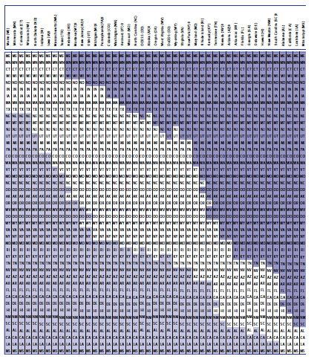
NAEP

Slide 41
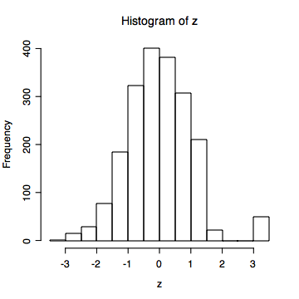
The most general (and irrelevant) case (2)
Benjamini and Yekutieli ‘01
One realization from
Extreme Joint dist’n for m=2000
Extreme joint dist’n for m=2
P₍₂₎
P₍₁₎
See also Blanchard and Roquain formulation by reshaping function

Slide 42
Do we loose from not attending to dependency
If the dependencies are strong – not much
Two examples:
  Block dependencies (haplotypes)
  Combining similar studies (we shall leave out)

Slide 43
Block dependence
If the test statistics have block dependencies (as in SNPs data residing on a haplotype)
…a bit more discoveries in the combined study than
before - just by the right amount to assure (if originally
independent), FDR=(m₀)/(m+j)q (or (m₀+j)/(m+j)q)
YB & DY

Slide 44
Open problem for two-sided tests
Even when X has PRDS distribution |X| does not - (when some hypotheses are true and some are not)
Nevertheless, simulation results show that the worst case is when all test statistics have correlation 1.

Slide 45
Open problem for two-sided tests
Nevertheless, for the linear step-up procedure, Simulation results show that the worst case is when all test statistics have correlation 1. Can it be proved?
Under this assumption, the FDR can be analytically written, and it is shown that
FDR ≤ q(m₀/m)(1+Σ_{j=m0+1} (1/j)/2 )≤ q,
Reiner ’07, Cohen ‘13
So still conservative, but if we use adaptive procedures care is needed.

Slide 46
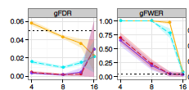

FDR or FWER control in GWAS? Why 5*10⁻⁶?
Peterson,Bogomolov, YB, Sabatti “…Error Controlling Strategies for Multi-Traits Association Studies”
(arXiv:1504.00701)
~300,000 SNPs, 100 traits (independent) MatrixEQTL software

Slide 47
(3) Weighted FDR controlling procedures
Comes in two flavors: Procedural & Conceptual
The Weighted BH procedure of Genovese Roeder and Wasserman (‘06)
Assign each hypothesis a weight w_{i,} Σw_{i}=m
Calculate new ‘p-values’
P*_{i}=P_{i}/ w_{i,}
Use BH procedure with P*_{I}
i.e sort them and work step-up
Note: What happens when all w_{i} =1? When w₁ =1 and all others 0?
Result: the FDR ≤ q. ( ≤ q(m₀/m))
Large power gain for high w_{i}; small loss for low w_{i}!

Slide 48
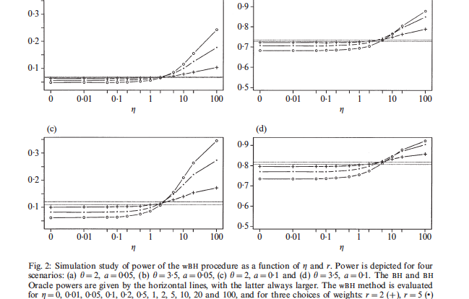
Review: Genome-Wide Significance Levels and Weighted Hypothesis Testing
(Kathryn Roeder and Larry Wasserman)

Slide 49
Weighted FDR controlling procedures
Two flavors: Procedural & Conceptual
The Weighted BH procedure of YB & Hochberg
Assign each hypothesis a weight w_{i,} Σw_{i}=m
Define weighted FDR as
Sort the original p-values, get P_{(i)} with associated weight i,
Calculate
Reject all k hypotheses with smallest p-values
Note: What happens when all w_{i} =1? When w₁ =m and all others 0?
Result: for PRDS test statistics

Slide 50

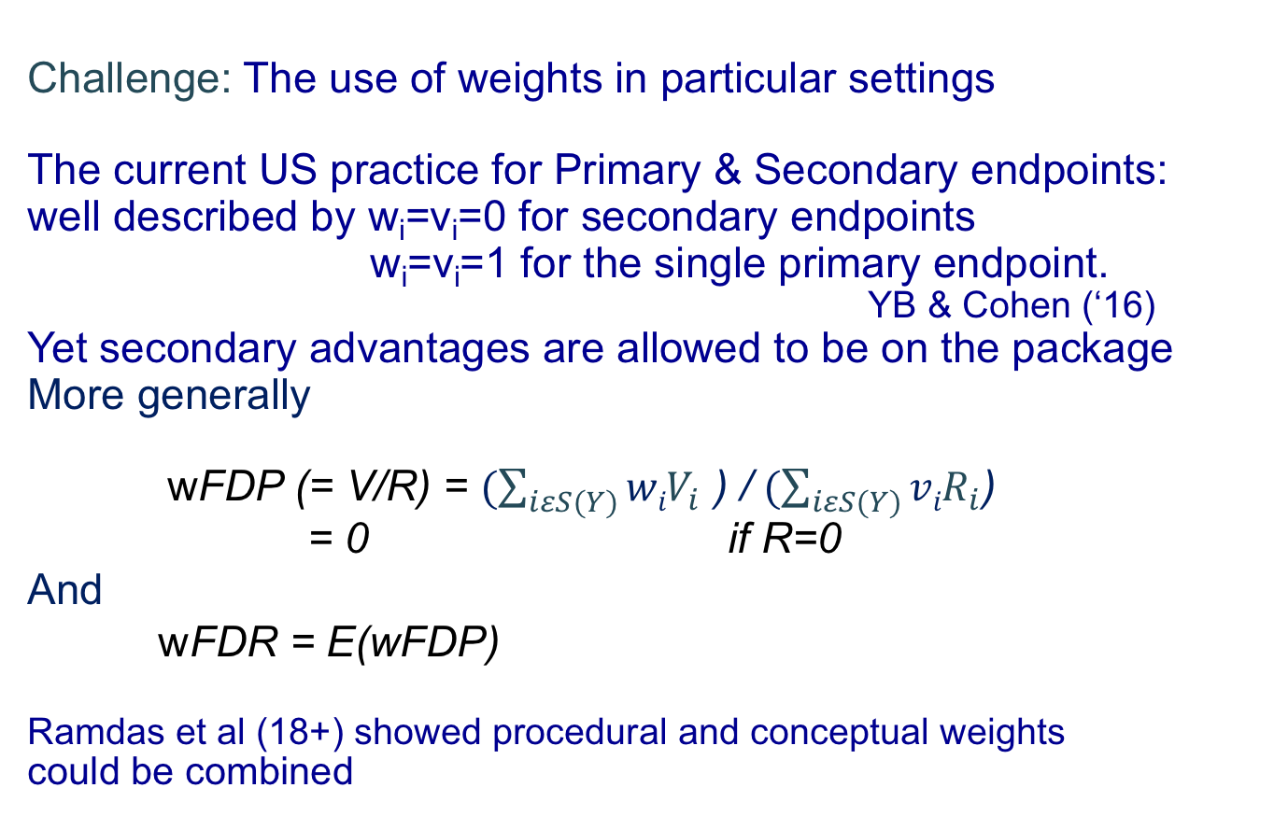
The use of weights
Challenge: The use of weights in particular settings
The current US practice for Primary & Secondary endpoints: well described by w_{i}=v_{i}=0 for secondary endpoints
w_{i}=v_{i}=1 for the single primary endpoint.
YB & Cohen (‘16)
Yet secondary advantages are allowed to be on the package
More generally
wFDP (= V/R) = $(\sum_{iεS(Y)}{{wiV}_{i}}$ ) / $(\sum_{iεS(Y)}{{viR}_{i}}$) = 0 if R=0
And
wFDR = E(wFDP)
Ramdas et al (18+) showed procedural and conceptual weights
could be combined

Slide 51
(4) Adaptive procedures that control FDR
Recall the m₀/m (=p₀) factor of conservativeness
Hence: if m₀ is known, the linear step-up procedure with q i/ m(m/m₀) = q i/ m₀ controls the FDR at level q exactly
i.e. an “FDR Oracle”
The adaptive procedure
  Estimate m₀ (or p₀) from the p-values
Schweder&Spjotvol (‘86), Hochberg&BY (‘90), BY&Hochberg (‘00)
Still very active area of research even now: `Parametric modeling; EM algorithm with mixtures; Ratio of densities at 0, Spectral analysis; Histogram analysis,…
Two procedures (plus 1) with proven performance under independence

Slide 52
Option 1:Two stage linear step-up procedure
  Stage I: Use BH with q/(1+q), rejecting r₁;
  if r₁=0 stop
  Stage II: Estimate m₀ = (m- r₁ )(1+q),
  Then use it again with q*= q m/ m₀
  YB, Krieger and Yekutieli (2006)

Slide 53
Behavioral Endpoint | .05/(1.05)(i/17) | p_{(i)} | .05/(1.05)(i/10)
Prop. Lingering Time | 0.0028 | 0.0029 | 0.0052
# Progression segments | 0. 0056 | 0.0068 | 0.0105
Median Turn Radius (scaled) | 0.0084 | 0.0092 | 0.0158
Time away from wall | 0.0112 | 0.0108 | 0.0211
Distance traveled | 0.0140 | 0.0144 | 0.0264
Acceleration | 0.0168 | 0.0146 | 0.0317
# Excursions | 0.0196 | 0.0178 | 0.0370
Time to half max speed | 0.0224 | 0.0204 | 0.0423
Max speed wall segments | 0.0252 | 0.0257 | 0.0476
Median Turn rate | 0.0280 | 0.0320 | 0.0529
Spatial spread | 0.0308 | 0.0388 | 0.0582
Lingering mean speed | 0.0336 | 0.0588 | 0.0634
Homebase occupancy | 0.0364 | 0.0712 | 0.0687
# stops per excursion | 0.0392 | 0.1202 | 0.0740
Stop diversity | 0.0420 | 0.1489 | 0.0793
Length of progression segments | 0.0448 | 0.5150 | 0.0761
Activity decrease | 0.0476 | 0.8875 | 0.0809
Significance of 8 Strain differences

Slide 54
Option 2:
Storey, Taylor, Siegmund (2004) modified:
Pre-determined λ (say λ=1/2): m₀=(m-r(λ)/(1-λ )
into m₀=(m+1-r(1/2)/(1-1/2 )
  and added the condition for rejection p_{i} ≤ λ
  They showed: FDR control under independence
  asymptotic control for weak dependency
  Unlike the original Storey’s procedure (2000,2003) which searched over all λ using bootstrapping

Slide 55
Behavioral Endpoint | p_{(i)} | p_{(i)} | 0.05 (i/6)
Prop. Lingering Time | 0.0029 | 0.0029
# Progression segments | 0.0068 | 0.0068
Median Turn Radius (scaled) | 0.0092 | 0.0092
Time away from wall | 0.0108 | 0.0108
Distance traveled | 0.0144 | 0.0144
Acceleration | 0.0146 | 0.0146
# Excursions | 0.0178 | 0.0178
Time to half max speed | 0.0204 | 0.0204
Max speed wall segments | 0.0257 | 0.0257
Median Turn rate | 0.0320 | 0.0320
Spatial spread | 0.0388 | 0.0388
Lingering mean speed | 0.0588 | 0.0588
Homebase occupancy | 0.0712 | 0.0712 | 0.108
# stops per excursion | 0.1202 | 0.1202 | 0.116
Stop diversity | 0.1489 | 0.1489 | 0.125
Length of progression segments | 0.5150 | 0.5150 | 0.133
Activity decrease | 0.8875 | 0.8875 | 0.141
Significance of 8 Strain differences
2= #{P_{i} ≥ .5}
m₀=(2+1)/(1-1/2)=6

Slide 56
Some comparisons:
  We found the Storey Taylor Siegmund procedure is most powerful under independence, e.g.
  m=256, m₀/m=.75, means at 1,2,3,4
  Oracle=1 BH: =0.94
  Two Stage: 0.96 M-Storey-Half =0.99

Slide 57
Under dependency
  However: it fails to control the FDR for some PRDS
  m=256, m₀/m=.75, fixed correlation=.25
  Oracle FDR: 0.049
  Two Stage: 0.049 M-Storey-Half: 0.090
  The problem does not disappear with large m

Slide 58
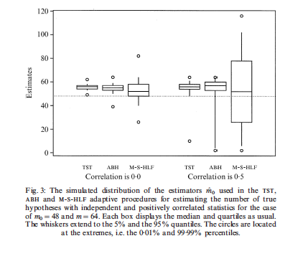
Why does dependency matter?

Slide 59
Some surprising results
If one restricts Storey’s estimator to λ=q (= say .05), performance under dependency improves dramatically
(Blanchard & Roquain ‘08,‘09)
  Important Caveat: In these estimators m₀>m possible!
  In practice it happens : 5/32 in a recent study of ours
  It should not be set to m because then FDR control is not assured

Slide 60
Resampling procedures
Yekutieli & BY (’99)
Efron et al (‘01), Storey(‘01), Storey & Tibshirani (’03)
Genovese & Wasserman (‘04) Troendle et al …
van der Laan & Dudoit (‘09)
Empirical Bayes
Efron (’03) … Efron’s book Large Scale Inference (’10)
Knockoff procedures
Candes & Foygel-Barber (14) Wald Lecture JSM 2017

Slide 61
One concern - different directions
The effect of CIs on multiple parameters:
Pr(all marginal intervals cover their parameters) < 0.95
The goal of Simultaneous CIs, such as Bonferroni-adjusted CIs, is to assure that Pr( all cover) ≥ 0.95
The effect of Selection
When only a subset of the parameters is selected for highlighting, for example the significant findings,
even the average coverage < 0.95
Selection of this form harms Bayesian Intervals as well (Wang & Lagakos ‘07 EMR, Yekutieli 2012)

Slide 62
The False Coverage-statement Rate (FCR)
YB & Yekutieli (’05)
A selective CIs procedure uses the data T
to select
to state confidence intervals for the selected
The False Coverage-statement Rate (FCR) of a selective CIs procedure is
(|S| may be 0 in which case the ratio is 0)
FCR is the expected proportion of coverage-statements made that fail to cover their respective parameters

Slide 63
Selection expressed by FCR
Bonferroni-selected
Bonferroni-adjusted intervals
Bingo -
but are we done?

Slide 64
Result: Any simultaneous confidence region CR(T), i.e. Pr(CR(T) includes μ) ≥ 1-α, which is projected to the coordinates to get simultaneous confidence intervals, controls the FCR of any selective CIs procedure at level α.
The price paid:
The FCR level is much too low.
It is even lower with less stringent selection

Slide 65
FCR adjusted selective CIs
(1) Apply a selection criterion S(T)
(2) For each i ε S(T),
construct a marginal 1- q |S(T)| / m CI
Thm: For any (simple) selection procedure S(), if
each marginal CI is monotone in α ε (0,1)
(ii) the components of T are independent or Positive Regression Dependent,
The above FCR-adjusted CIs enjoy FCR ≤ q.
If Test μ_{i}=0 & Select controlling FDR (with BH)
Select i <-> the FCR-adjusted CI doesn’t cover 0

Slide 66
General: FCR adjusted selective CIs
(1) Apply the selection criterion S(T)
(2) For each i ε S(T), partition T to T_{i} and T^{(i),}
R_{min} (T^{(i)})=min_{t} { |S( T^{(i)},T_{i}=t)| | i ε S(T^{(i)},T_{i}=t) }
(3) For each i ε S(T )
construct a marginal 1- R_{min} (T^{(i)})q/m CI
Theorem: For any selection procedure S(), if
each marginal CI is monotone in α ε (0,1)
(ii) the components of T are independent,
The FCR-adjusted CIs defined before enjoy FCR ≤ q.

Slide 67
Some properties
if selection is high, R_{min} is small and wider intervals are needed. If R_{min}= 1 these are Bonferroni intervals.
If all are selected R_{min} = m and no adjustment is needed.
Thus FCR adjustment is adaptive
For many selection rules including unadjusted testing, Bonferroni testing, linear stepup testing, R_{min} is taken over a single number, and is simply |S(T)|.
This is not the case for adaptive FDR testing procedures (e.g. YB&Hochberg ‘00, YB,Krieger&Yekutiel ‘01,?, Storey,Siegmund & Taylor ‘02,‘04, etc.)

Slide 68
How well do we do?
Ex. 5: FCR of Linear-Stepup-selected, FCR-adjusted,
Theorem: Under some additional conditions,
if for all i=1,2,…,m, μ_{i} is converges either to 0 or to infinity,
the FCR -> q.

Slide 69
FCR controlling selective CIs
Directly linked to the linear step-up FDR controlling procedure in BH ‘95, for testing whether μ_{i}=0.
If selection is made according to the above the procedure is as following:
(Old) Convert the T_{i} ‘s to p-values testing μ_{i} =0.
After sorting the p-values P₍₁₎ ≤ P₍₂₎ ≤…≤ P_{(m),}
Let R = max {i | P_{(i)} ≤ iq/m }
(New) So S(T)={i | P_{(i)} ≤ Rq/m} and its size is R.
For each μ_{i} , i ε S(T), construct a marginal 1- Rq/m level CI.

Slide 70
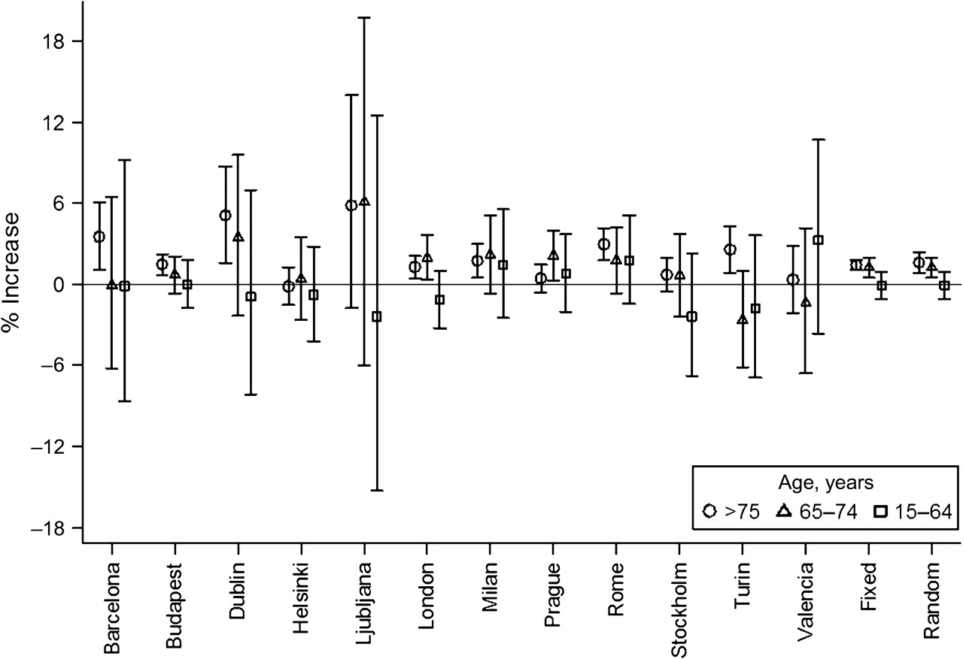

City-specific and pooled percentage increase adjusting for barometric pressure, … and FDR adjusted for selection using BH
Z_{1-0.025(5/36)}
Z_{1-0.025}
~1.3
Analitis A et al. Am. J. Epidemiol. 2008;168:1397-1408
See a related review by Biggeri,Catelan, Barbone
American Journal of Epidemiology © The Author 2008. Published by the Johns Hopkins Bloomberg School of Public Health. All rights reserved. For permissions, please e-mail: journals.permissions@oxfordjournals.org.
Notes:
City-specific and pooled percentage increase (vertical lines: 95% confidence intervals) in cerebrovascular mortality for European study subjects >75, 65–74, and 15–64 years of age associated with a 1°C decrease in minimum apparent temperature (average of lags 0–15), adjusting for barometric pressure, wind speed, day of the week, holiday, calendar month, and time trend during the cold season (October–March), 1990–2000.

Slide 71
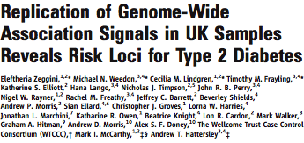
Selection by a Table
SCIENCE, 1 JUNE 2007

Slide 72
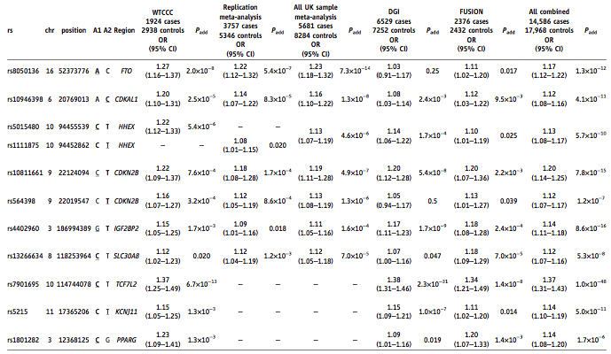
Main Table

Slide 73
Odds ratio point and CI estimates for confirmed T2D susceptibility variants
1-.05*10/400000
Region Odds ratio 0.95 CIs FCR-adjusted CIs
FTO 1.17 [1.12, 1.22] [1.05, 1.30]
CDKAL1 1.12 [1.08, 1.16] [1.03, 1.22]
HHEX 1.13 [1.08, 1.17] [1.02, 1.25]
CDKN2B 1.20 [1.14, 1.25] [1.07, 1.34]
CDKN2B 1.12 [1.07, 1.17] [1.00, 1.25]
IGF2BP2 1.14 [1.11, 1.18] [1.06, 1.23]
SLC30A8 1.12 [1.07, 1.16] [1.01, 1.24]
TCF7L2 1.37 [1.31, 1.43] [1.23, 1.53]
KCNJ11 1.14 [1.10, 1.19] [1.03, 1.26]
PPARG 1.14 [1.08, 1.20] [1.00, 1.30]
Using marginal CI is more common than marginal tests.
Alas, protecting from the effect of selection in testing
does not solve the problem in estimation

Slide 74
Odds ratio point and CI estimates for confirmed T2D susceptibility variants
1-.05*10/400000
Region Odds ratio 0.95 CIs FCR-adjusted CIs
FTO 1.17 [1.12, 1.22] [1.05, 1.30]
CDKAL1 1.12 [1.08, 1.16] [1.03, 1.22]
HHEX 1.13 [1.08, 1.17] [1.02, 1.25]
CDKN2B 1.20 [1.14, 1.25] [1.07, 1.34]
CDKN2B 1.12 [1.07, 1.17] [1.00, 1.25]
IGF2BP2 1.14 [1.11, 1.18] [1.06, 1.23]
SLC30A8 1.12 [1.07, 1.16] [1.01, 1.24]
TCF7L2 1.37 [1.31, 1.43] [1.23, 1.53]
KCNJ11 1.14 [1.10, 1.19] [1.03, 1.26]
PPARG 1.14 [1.08, 1.20] [1.00, 1.30]
and FCR adjusted intervals

Slide 75
20 parameters to be estimated with 90% CIs
3/20 do not cover
3/4 CI do not cover
when selected
These so selected 4
will tend to fail,
or shrink back,
when replicated.
Selection of this form
harms Bayesian Intervals
as well
(Wang & Lagakos ‘07 EMR, Yekutieli 2012)

Slide 76
(a) y_{i}~ N(θ_{i},σ); σ = 1 ; θ_{i} ~N(0, τ); τ = 0.5 ; N = 1e+06 *
95% posterior credible intervals PC_{i} using model (a)
PC_{i} excludes 0: 95 (0.01%) 2.1% wrong sign
95% regular intervals CI_{i}
Ci_{i} excludes 0: 73,995 (7.4%) 14.3% wrong sign
But
FCR confidence intervals 1% wrong sign
*Example from Andrew Gelman’s website
Notes:
12 (0%) 95% BH-selected FCR-adjusted intervals are selected by BH, and all exclude 0 0% of these have the wrong sign (Type S error) Factor of BH interval to classical is 2.547

Slide 77
(a) y~ N(θ,σ); σ = 1 ; θ~N(0, τ); τ = 0.5 ; N = 1e+06 *
(b) w.p. 0.001 θ_{ι}∼θ_{ι}+Ν(0,3)
95% posterior credible intervals using model (a)
Under (a)
PC_{i} fails to cover θ_{ι} 49,476 (4.95%)
PC_{i} excludes 0: 95 (0.01%) 2.1% wrong sign
Fail to cover θ_{ι} among the 0 excluding 6.3%
Under (b)
PC_{i} fails to cover 50,863 (5.1%)
PC_{i} excludes 0: 269 (0.03%) 0% wrong sign
Fails to cover θ_{ι} among the 0 excluding 73.2%
*Example from Andrew Gelman’s website

Slide 78
The False Coverage-statement Rate (FCR)
YB & Yekutieli (’05)
A selective CIs procedure uses the data T
to select ; number selected=| S(T) |
to state confidence intervals for the selected
V_{CI} is # constructed intervals not covering their parameters
Define Q_{CI} = V_{CI} / |S| if |S| > 0
= 0 if |S| = 0 i
The False Coverage-statement Rate (FCR) of the selective CIs procedure is
FCR = E_{T} (Q_{CI})
FCR is the expected proportion of coverage-statements made that fail to cover their respective parameters

Slide 79
Summing up
Dependent estimators: Some result for positive regression dependent statistics and one-sided confidence intervals are available. There is also a general procedure (at the cost of inflating the level of CIs by a factor (1+1/2+1/3+,…,+1/m) )
There two sets of tools for two purposes.
Tomorrow we’ll sharpening the new set of tools: Potential benefits from tuning the adjustment procedure to specific selection rules

Slide 80

FDR a thing of the past?

Slide 81
Historical Perspective (I)
FDR control in BH was motivated by a paper of Soriç (1987).
In the direction in which we went:
Prof. Victor (1997) brought to my attention his note from (1982) with independent previous efforts:
  Prob( V > k ) ≤ α for pre-chosen k > 1 !!!
  Prob( V > γ m ) ≤ α
  E(V (a))/R(a) ≤ α (same as Soriç)
Harvanek and Chytil (1983) gave procedure for (2)
Hommel and Hoffman(1987) gave procedure for(1)
but commented about lack of procedure for (3)

Slide 82
Historical Perspective (II)
Shaffer (1997) brought back forgotten references
  Eklund (unpublished work in Swedish)
  Seeger(1968) FWER controlled in weak sense, but not in the strong sense
Simes (1986) suggested to extend the same test of the single intersection hypothesis to multiple inferences
Hommel (1988)
Hochberg (1988) and Hommel (1988)
the series is constants are q/(m+1-i)
Sen (1998a) points out to the classical Ballot Theorem
Names: FDR procedure (SAS); Benjamini-Hochberg (BH); Linear Step-up

